Slide 1
Chapter 5 – JavaScript
#25 – Section 1
Node JS Installation

Slide 2
Windows Installation
Open your Web browser
Type http://nodejs.org in the address bar
Click on the button to down the latest version of Node JS Installer executable
After download, run the Node JS Installer executable
Accept terms, and defaults

Slide 3
Mac OS X/Linux Installation
Open your Web browser
Type http://nodejs.org in the address bar
Click on the button to down the latest version of Node JS Installer executable
How you run an executable may be different, but you know how to do that already

Slide 4
Verify Node JS Installation
Open a command line prompt
Windows users usually type ‘cmd’
Type “node” and press the enter key
If you get a prompt that loos like this “>”, then node is installed successfully
Type “1 + 2” and press enter key to get “3”
Type ctrl+c twice to exit Node JS

Slide 5
Chapter 5 – JavaScript
#26 – Section 2
Birth of a Program

Slide 6
Human to Computer
Before the computer can do anything, it has to be presented with instructions
Told what to do
Source Code or just Code
Programmer writes the Code
Optionally converts “code” to another format
Makes it easier for the computer to “understand”
understand => execute
This process is call “compiling”
Now the computer run the code

Slide 7
The Process
Idea
Code
write
what you wan the computer to do
instructions that is human readable
compile (convert)
Computer
Machine Language
execute
Give encoded instruction to computer to perform (execute/run)
Create a program by writing instructions that is human readable

Slide 8



The Process (cont.)
Human readable
code in a file
Compiler
Computer/machine
instructions in a file
execute

Slide 9
Example – Hello World in C++
Code
#include <iostream>
int main(int argc, char* argv[]){
cout << “Hello, world!” << endl;
}
Compile
g++ hello.cpp -o hello.exe
Execute
hello.exe

Slide 10
Example – Hello World in JavaScript
Code
console.log(“Hello, World!\n”)
Compile & Execute
node hello.js

Slide 11
Chapter 5 – JavaScript
#27 – Section 3
Getting The Code

Slide 12
How To Access The Code
Location: http://github.com/xiliax/web-programming-fundamentals
Two Ways To Access The Code
Online with web browser
Point web browser to:
http://github.com/xiliax/web-programming-fundamentals
Clone a copy to your computer using ‘git’
Command line, type the following:
git clone https://github.com/xiliax/web-programming-fundamentals.git
Brackets

Slide 13
Chapter 5 – JavaScript
#28 – Section 4
Hello World

Slide 14
JavaScript
Core Features
High Level : easier to read and write code, gets rid of fluff/boilerplate, forgiving, …
Dynamic : allows extension and changes at runtime
Untyped : flexible in operations used on different types of data
Interpreted : No step for producing a binary executable or any other intermediate artifact
Reference:
https://en.wikipedia.org/wiki/JavaScript

Slide 15
“Hello World” Program
Purpose
One of the simplest complete program in a programming language
Feature
Demonstrates a number of features of the language
Structure
History
Traces back to languages in the C pedigree (B, BCPL)
Reference: https://en.wikipedia.org/wiki/%22Hello,_World!%22_program

Slide 16
hello.js
// My ‘hello world’ program in JavaScript
console.log(“Hello, World”)

Slide 17
A Breakdown Of ‘hello world’
Statement
Function call
Function argument(s)
Calling the ‘log’ function with arguments
Object
Eg: ‘console’
Membership Resolution
Using the ‘.’ or ‘dot’ operator
Eg: console.log()
Comments
Single line using //
Multi-line using /* … */

Slide 18
Basic Data Types
Bit
Representing a binary value or 2-value system
Byte : 8-bits
Character can be one or two bytes
Number
20
495.97
10e-8
String
“Hello, World\n”
‘Hi’

Slide 19
Chapter 5 – JavaScript
#29 – Section 5
Two Flavors Of JavaScript

Slide 20
Native Home Of JavaScript
Created for the Web browser
Works along side HTML and CSS
1 of the cornerstone technologies for Web programming, along with HTML and CSS

Slide 21
JavaScript In The Web Browser
<!DOCTYPE html>
<html>
<head>
<title></title>
</head>
<body>
<script>
console.log("hello world")
console.log("3 + 5 = ", 3 + 5)
</script>
</body>
</html>

Slide 22
JavaScript In The Web Browser (cont.)
<!DOCTYPE html>
<html>
<head>
<title></title>
</head>
<body>
<script>
alert("hello world")
alert("3 + 5 = ", 3 + 5)
</script>
</body>
</html>

Slide 23
Web Browser: JavaScript Console
Use for debugging and seeing code errors
<!DOCTYPE html>
<html>
<head>
<title></title>
</head>
<body>
<script>
console.log("hello world")
console.log("3 + 5 = ", 3 + 5)
</script>
</body>
</html>

Slide 24
Web Browser: JavaScript Console (cont.)
Open JavaScript Console
Chrome: View -> Developer -> JavaScript Console
Firefox: Tools -> Web Developer -> Web Console
Safari: http://bfy.tw/3pD2
Internet Explorer: Right-click, select “Inspect Element”, click “Console” tab.
In the console, type:
console.log("hello world")
console.log("3 + 5 = ", 3 + 5)

Slide 25
Interactive Web Pages
To simple examples of dynamic web pages:
Simple calculator using +, -, *, and /
Simple calculator with history

Slide 26
Browser Abstraction
Web Browser
JS
Engine

Slide 27
JS Engine Liberation
Web Browser
NodeJS Application
JS
Engine
JS
Engine

Slide 28
Chapter 5 – JavaScript
#30 – Section 6
Values & Variables

Slide 29
Definition: Value
What is a ‘value’?
Verrol’s definition:
A value is an abstraction to represent a computed result
Not all values computed, some values just represents themselves. When a value stands for itself, we call it a literal. NOTE, a literal is still a value.
Examples:
6
6 is a value and also a literal, it stands for itself
3 + 1
will compute the value 4, but we don’t see for here
3.141592
“Verrol”
“Verrol” is a string literal, it is not a computed value, but still a value
true
true is also a literal in JavaScript.

Slide 30
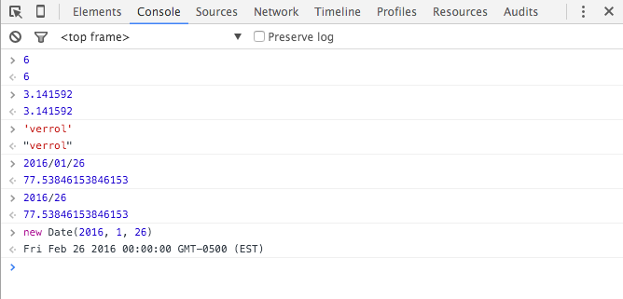
Demo: Values
Using the Brower JavaScript console:

Slide 31
Definition: Variable
What is a ‘variable’?
Verrol’s definition:
A variable is a named abstraction to recall or reference a value
A variable can be used anywhere a value is required/expected.
Examples:
itemCount
Could contain the value 6
pi
Contains the value 3.141592
myName
Contains the value “Verrol”
isLoggingEnabled
Could contain the value true

Slide 32
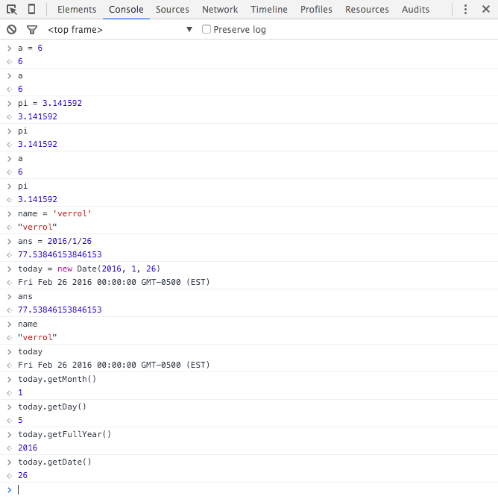
Demo: Variables
Using the Brower JavaScript console:

Slide 33
Chapter 5 – JavaScript
#31 – Section 7
Values, Variables, Data Types

Slide 34
Definition: Data & Data Type
What is ‘data’?
‘data’ is another name for ‘value’
The words ‘data’ and ‘value’ can be used interchangeably
What is ‘data type’?
Verrol’s definition:
A ‘data type’ is the format or representation of the data/value
In other words, it is the grouping of similar values
Examples:
Number
String
Date
Boolean

Slide 35
My Data Type Tree
Data Type
Number
Whole
Float
String
Boolean
Date
Container
Array
Function
Hash
Object

Slide 36
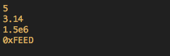
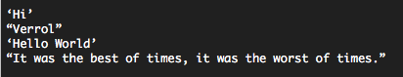
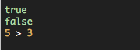
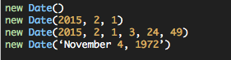
Example Data Types
Number
String
Boolean
Date

Slide 37
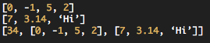
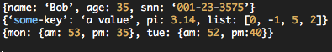
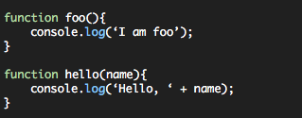
Example Data Types
Array
Hash
Function

Slide 38
Chapter 5 – JavaScript
#32 – Section 8
Functions

Slide 39
Definition: Functions
What is a ‘function’?
Verrol’s definition:
A ‘function’ ’ is a name given to a collection/set of statements
What are the benefits of functions?
Reuse
Organization
Abstraction

Slide 40
Function Syntax
Named Function
Compact Syntax
function name([argument list]){
body
}
Argument List
Optional comma separated list of variable names
Body
One or more statements

Slide 41
Function Syntax
Named Function
Expanded
function name([arg0, arg1, …, argN]){
statement0;
statement1;
...
statementN;
}

Slide 42
Function Syntax
Anonymous Function
Compact Syntax
var name = function([argument list]){
body
}
Expanded
var name = function([arg0, arg1, …, argN]){
statement0;
statement1;
...
statementN;
}

Slide 43
My Data Type Tree
Data Type
Number
Whole
Float
String
Boolean
Object
Date
Container
Array
Hash
Function

Slide 44
Using Functions
Function Name followed by ‘(‘ and ‘)’
If functions doesn’t require arguments/parameters, leave the parameter list empty
Definition:
function name ([argument list]){
body
}
Usage:
name([…])

Slide 45
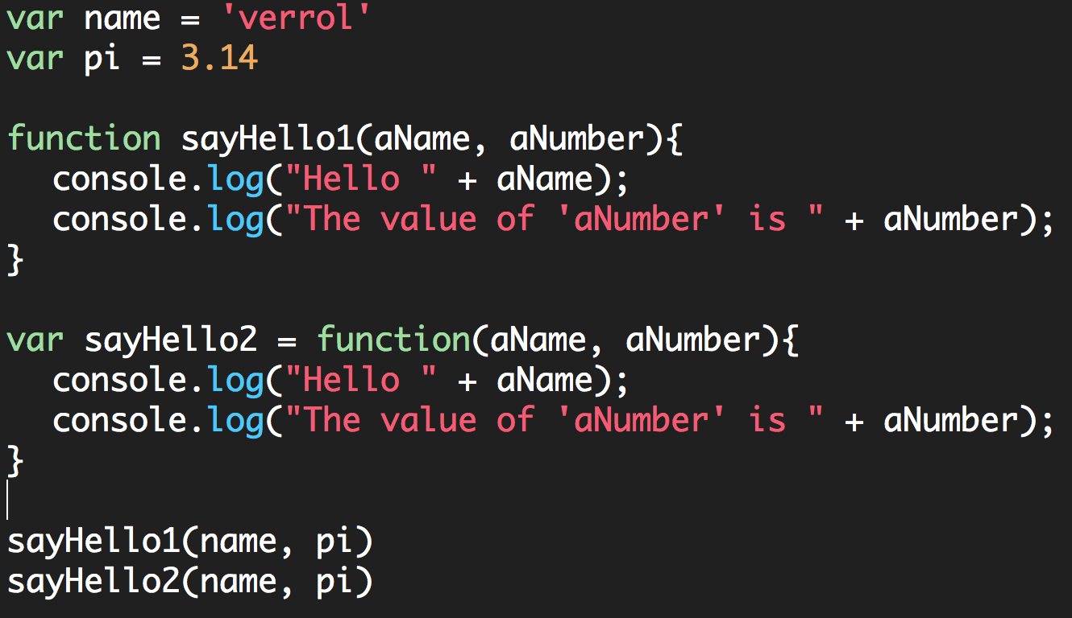
Example-01

Slide 46
Chapter 5 – JavaScript
#33 – Section 9
Functions : More On Usage

Slide 47
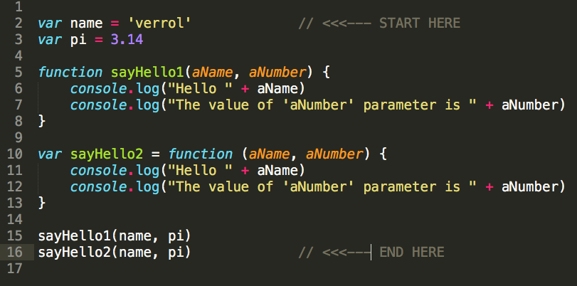
C05S08 : Example-01.js

Slide 48
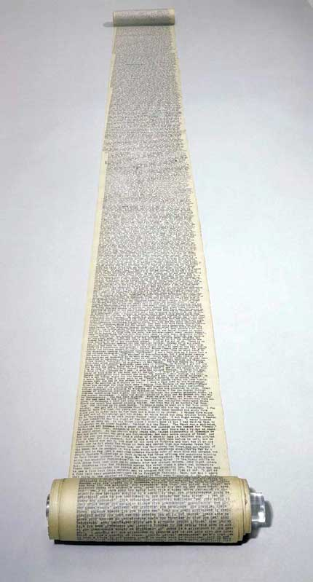
Your Awesome Program
START
END

Slide 49
Your Awesome Program
START
Repetition
END

Slide 50
Introduce Function(s)
START
foo()
Repetition
END

Slide 51
Introduce Function(s)
START
foo()
Repetition
END

Slide 52
Chapter 5 – JavaScript
#34 – Section 10
Containers: Arrays

Slide 53
Problem
Record Temperature reading at 8am, 12pm, and 6pm for a week
Day 1: 80°, 83°, and 76°
Day 2: 79°, 83°, and 79°
Day 3: 80°, 85°, and 80°
Day 4: 81°, 87°, and 79°
Day 5: 72°, 79°, and 75°
Day 6: 75°, 79°, and 72°
Day 7: 81°, 88°, and 77°

Slide 54
Definition: Array
What is a ‘array’?
Verrol’s definition:
An ‘array’ is a name given to a collection/set of values
What are the benefits of arrays?
Grouping of related values

Slide 55
Why Arrays?
Record Temperature reading at 8am, 12pm, and 6pm for a week
Day 1: 80°, 83°, and 76°
Day 2: 79°, 83°, and 79°
Day 3: 80°, 85°, and 80°
Day 4: 81°, 87°, and 79°
Day 5: 72°, 79°, and 75°
Day 6: 75°, 79°, and 72°
Day 7: 81°, 88°, and 77°

Slide 56
Why Arrays?
Day 1: 76°, 81°, 79°
Day 2: 79°, 83°, 80°
Day 3: 80°, 85°, 80°
Day 4: 81°, 87°, 79°
Daily Grouping
Day 5: 72°, 79°, 75°
Day 6: 75°, 79°, 72°
Day 7: 81°, 88°, 77°

Slide 57
Why Arrays?
Day 1: 76°, 81°, 79°
Day 2: 79°, 83°, 80°
Day 3: 80°, 85°, 80°
Day 4: 81°, 87°, 79°
Weekly Grouping
Day 5: 72°, 79°, 75°
Day 6: 75°, 79°, 72°
Day 7: 81°, 88°, 77°

Slide 58
Array Syntax
Simple/Compact Syntax
[element0, element1, element2, …, elementN]
Formal Syntax
new Array(element0, element1, element2, …, elementN)

Slide 59
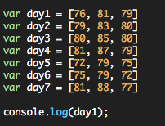
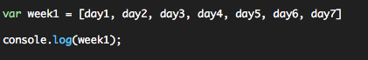
Basic Array Usage

Slide 60
Conclusion
What have we learned?
Arrays are useful for group related values
Creating an array is fairly simple
JavaScript’s console.log() function knows how to print an array

Slide 61
Chapter 5 – JavaScript
#35 – Section 11
Arrays: More On Usage

Slide 62
Topics
How to access elements of an array?
How to count the elements in an array?
How to modify an array, add/remove elements?

Slide 63
Why Arrays?
Record Temperature reading at 8am, 12pm, and 6pm for a week
Day 1: 80°, 83°, and 76°
Day 2: 79°, 83°, and 79°
Day 3: 80°, 85°, and 80°
Day 4: 81°, 87°, and 79°
Day 5: 72°, 79°, and 75°
Day 6: 75°, 79°, and 72°
Day 7: 81°, 88°, and 77°

Slide 64
Why Arrays?
Day 1: 76°, 81°, 79°
Day 2: 79°, 83°, 80°
Day 3: 80°, 85°, 80°
Day 4: 81°, 87°, 79°
Daily Grouping
Day 5: 72°, 79°, 75°
Day 6: 75°, 79°, 72°
Day 7: 81°, 88°, 77°

Slide 65
Basic Array Usage
Day 1: 76°, 81°, 79°
Day 2: 79°, 83°, 80°
Day 3: 80°, 85°, 80°
Day 4: 81°, 87°, 79°
Day 5: 72°, 79°, 75°
Day 6: 75°, 79°, 72°
Day 7: 81°, 88°, 77°

Slide 66
An Array Illustrated
Individual values
Array: named grouping
Elements
0
1
2
3
4
5
Index: element address
6
length
0
1
2
3
4
5

Slide 67
Access Elements of An array
Use the ‘[]’, the array ‘index operator’
Access an element:
array[index]
* Index: an integer value
Length or count of array elements:
array.length
* Return an integer value

Slide 68
Conclusion
How to access elements of an array using ‘[]’, the array index operator
How to get the length of an array using the ‘length’ property
Resources:
Mozilla Developer Network – Array Documentation
https://developer.mozilla.org/en-US/docs/Web/JavaScript/Reference/Global_Objects/Array

Slide 69
Chapter 5 – JavaScript
#36 – Section 12
Arrays: Add/Remove Elements

Slide 70
Topics
How to modify an array’s?
Grow or shrink an array

Slide 71
An Array Illustrated
Front
End
0
1
2
3
4
5

Slide 72
Grow : Add Element(s)
Front
2
3
4
5
6
7
End
0
1
2
3
4
5
Add to
front
1
2
3
4
5
6
7
0
1
2
3
4
5
6
2
3
4
5
6
7
8
Add to
end
0
1
2
3
4
5
6
0
1
2
3
4
5
6
Add at index-X

Slide 73
Shrink: Remove Element(s)
Front
1
2
3
4
5
6
End
0
1
2
3
4
5
Remove
From front
1
2
3
4
5
6
0
0
1
2
3
4
1
2
3
4
5
6
Remove
From end
0
1
2
3
4
5
1
2
4
5
6
0
1
2
3
4
Remove at index-X

Slide 74
Array ‘end’ Operations
Add elements to the end of an array:
Array.push(<value>)
Add to
end
0
1
2
3
4
5
6
Add elements to the end of an array:
Array.pop()
1
2
3
4
5
6
Remove
From end
0
1
2
3
4
5

Slide 75
Array ‘front’ Operations
Add elements to the end of an array:
Array.unshift(<value>)
Add to
front
1
2
3
4
5
6
7
0
1
2
3
4
5
6
Add elements to the end of an array:
Array.shift()
Remove
From front
1
2
3
4
5
6
7
0
0
1
2
3
4
6

Slide 76
Chapter 5 – JavaScript
#37 – Section 13
Arrays: Advance Usage

Slide 77
Topics
What are some of the other Array operations available?
forEach()
every()
map()
filter()
And more

Slide 78
forEach()
0
1
2
3
()
()
()
()

Slide 79
Print Temperature Taken per Day
76
81
79
0
1
2
(…)
(…)
(…)
It was 79 deg at 6pm
It was 81 deg at 12pm
It was 76 deg at 8am

Slide 80
reduce()
0
1
2
3
4
5
Reduce()

Slide 81
Average Daily Temperature
(76 + 81 + 79)/3 => 236/3 => 78.67
76
81
79
0
1
2
sum()
236

Slide 82
Conclusion
Array are very cool
Fairly easy to use
Flexible
Provides a number of useful methods out of the box
Resources:
Mozilla Developer Network – Array Documentation
https://developer.mozilla.org/en-US/docs/Web/JavaScript/Reference/Global_Objects/Array

Slide 83
Chapter 5 – JavaScript
#38 – Section 14
Objects: Introduction

Slide 84
Topics
What is an Object?
What kind of data/values can be stored in Objects?
Where can Objects be used?
And more…

Slide 85
Problem
Record the name, age, date-of-birth, and favorite foods for some family and friends:
Name | Age | DoB | Favorite Foods
Bob | 13 | 2003/01/23 | Pizza and Hamburgers
Clint | 43 | 1972/10/01 | Chinese, Italian, and Mexican
Uri | 57 | 1958/08/12 | Pizza, Hot dogs, and Steaks
Frank | 23 | 1992/05/09

Slide 86
Observation About The Data
We could create a variable name, age, etc each holding an array of the set of data.
Pro: Seems straight forward
Con: Not easy to get all the values for one person
We could create an array for each person
Pro: groups related data
Con: would still have to remember which index holds which type of data
Name | Age | DoB | Favorite Foods
Bob | 13 | 2003/01/23 | Pizza and Hamburgers
Clint | 43 | 1972/10/01 | Chinese, Italian, and Mexican
Uri | 57 | 1958/08/12 | Pizza, Hot dogs, and Steaks
Frank | 23 | 1992/05/09

Slide 87
As An Array
index
value
0
“Bob”
1
13
2
new Date(2013, 0, 23)
3
[“Pizza”, “Hamburger”]

Slide 88
Key and Value
key
value
name
“Bob”
age
13
dob
new Date(2013, 0, 23)
ffood
[“Pizza”, “Hamburger”]

Slide 89
Object
Object
name
“Bob”
age
13
dob
new Date(2013, 0, 23)
ffood
[“Pizza”, “Hamburger”]

Slide 90
Definition: Object
What is a ‘object’?
Verrol’s definition:
An ‘object’ is a name given to a collection/set of properties. Where each property is a {key, value} pair.
What are the benefits of objects?
Grouping of related values accessible by user defined keys.

Slide 91
Object
Object
name
“Bob”
Property
age
13
dob
new Date(2013, 0, 23)
ffood
[“Pizza”, “Hamburger”]

Slide 92
Object Syntax
Simple/Compact Syntax
{keyA: valueA, keyB: valueB, keyC: valueC, …, propertyN}
Formal Syntax
var obj = new Object()
obj.keyA = valueA
obj.keyB = valueB
...

Slide 93
Access Elements of An object
Use the ‘[]’, the ‘index operator’
If the key is not a simple string:
object[key]
* key: any computed value
Use the ‘.’, the ‘dot operator’:
object.key
* key: property name

Slide 94
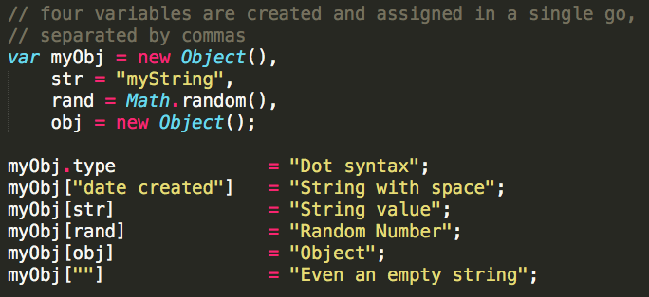
Property Name or Key
Can be anything, but must be specified in a way to avoid ambiguity.
Examples:

Slide 95
Conclusion
Objects are very cool
Fairly easy to use
Flexible
Resources:
Mozilla Developer Network – Object Documentation
https://developer.mozilla.org/en-US/docs/Web/JavaScript/Reference/Global_Objects/Object

Slide 96
Chapter 5 – JavaScript
#39 – Section 15
Objects: “Everything” Is An Object

Slide 97
Topics
Is everything really an ‘objet’?
Playing with Objects

Slide 98
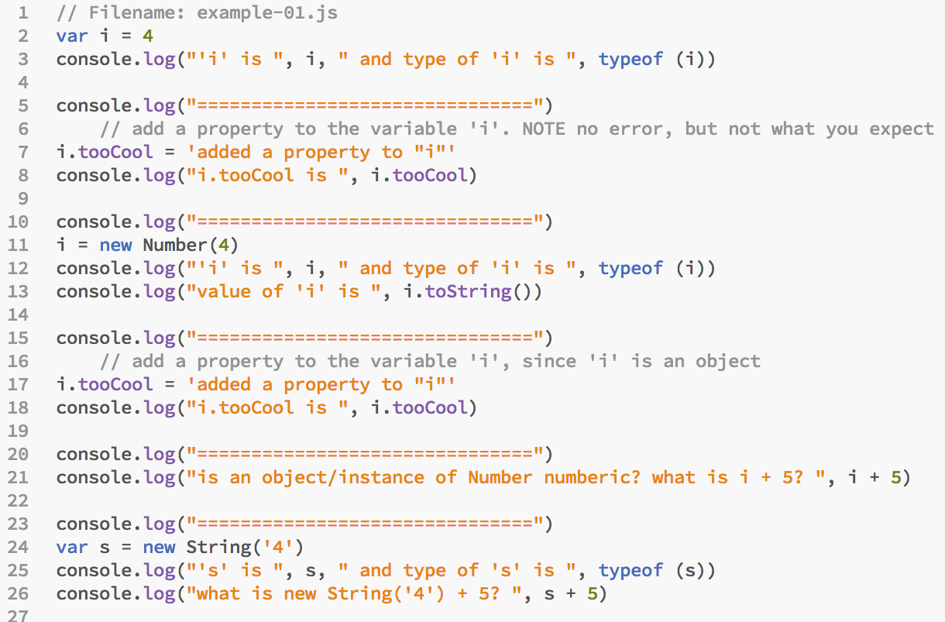
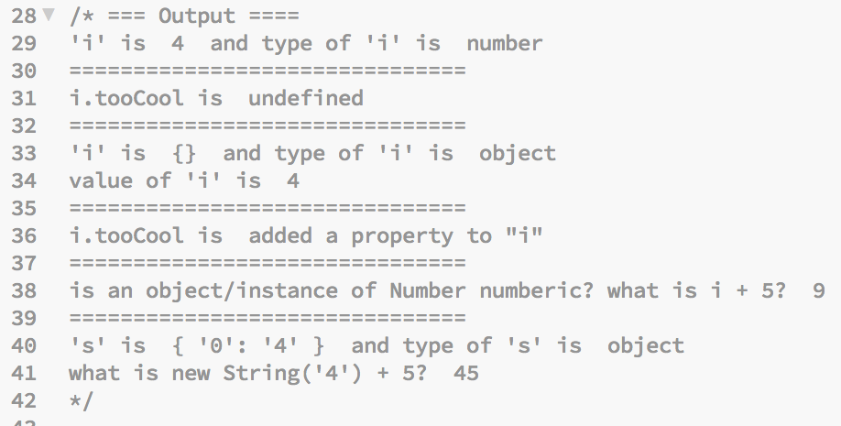

Slide 99
Classification
Animal
Dog
Cat
Human

Slide 100
JavaScript Value Type Class Hierarchy
Object
Number
Array
Function
Date
String

Slide 101
Class vs. Instance/Object
Class | Instance/Object | Notes
Dog | Rex | A dog name ‘Rex’
Number | 5, a | To examples or instances of the Number type. ‘a’ is a variable containing a numeric value, and ‘5’ is itself a number
String | “all men are created”

Slide 102

Recipe vs. Product
Cake recipe
Preparation & Baking
Product = Cake
Class
Create instance using ‘new’
Instance

Slide 103
Creating Instances in JavaScript
Class | Instance/Object | Notes
Object | {} | An instance of the generate Object class
Array | [] | An instance of the specific class ‘Array’
Number | new Number(5) | An instance of the Number class to represent a numeric value
Function | new foo() | An instance of the ‘foo’ function

Slide 104
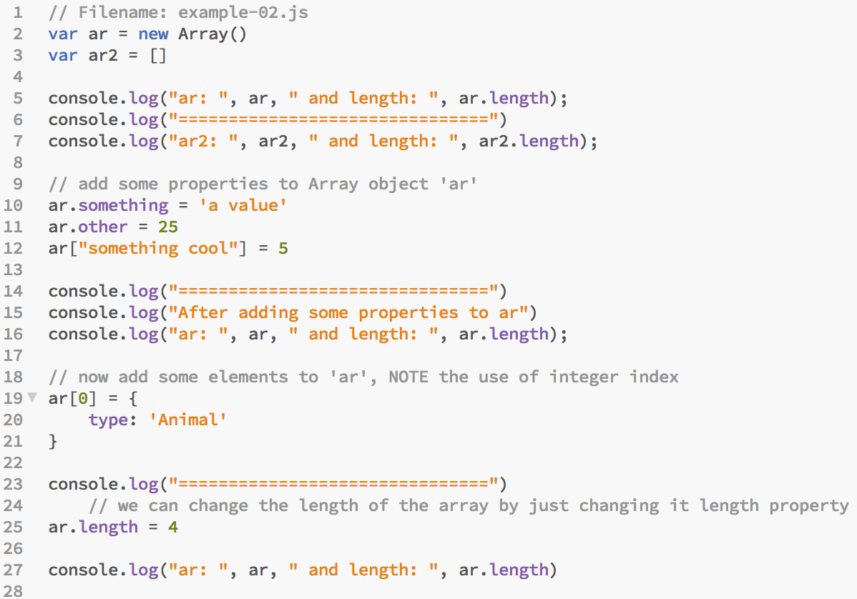
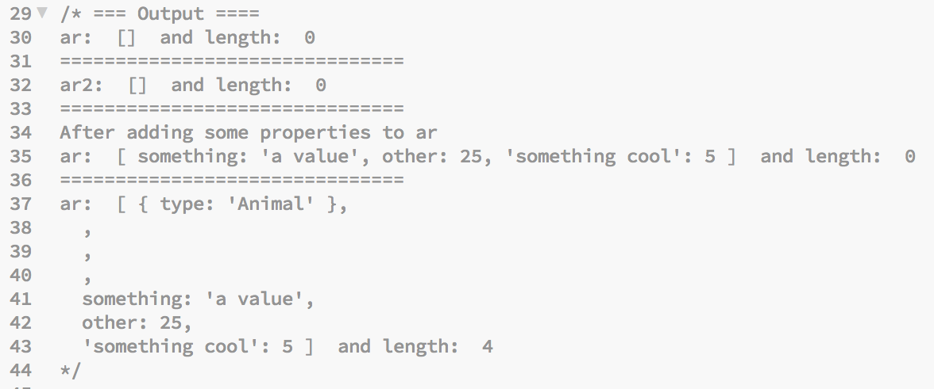

Slide 105
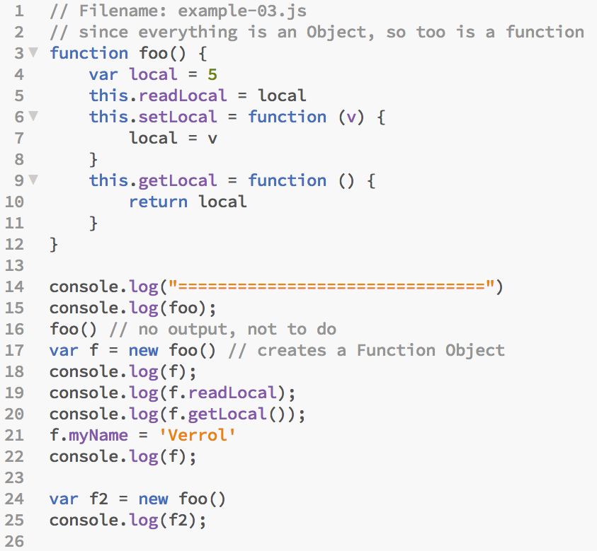
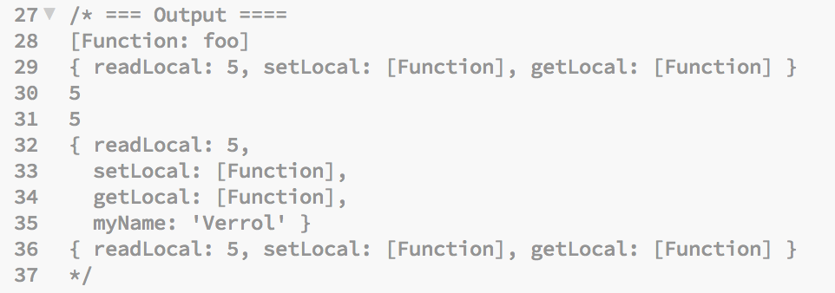

Slide 106
Conclusion
Objects are awesome
A bit confusing
But still flexible
Resources:
Mozilla Developer Network – Object Documentation
https://developer.mozilla.org/en-US/docs/Web/JavaScript/Reference/Global_Objects/Object

Slide 107
Chapter 5 – JavaScript
#40 – Section 16
Control Flow – If Statement

Slide 108
Topics
What is ‘Control Flow’?
The ‘if’ Statement

Slide 109
c05s39 – Example-03.js

Slide 110
Our Programs So Far
Start
Statement 1
Statement 2
Statement 3
Statement …
Statement N
End

Slide 111
What “if”?
Instead of this
You want this
true
false

Slide 112
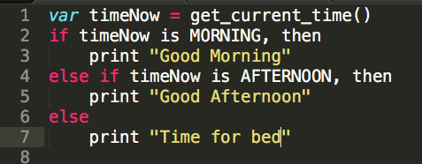
Changing the Flow
What if we wanted a program that prints an appropriate greeting based on the time of day?
A program like that might look this in pseudo code (not quite code):

Slide 113
Definition: Control Flow
What is ‘Control Flow’?
Verrol’s definition:
A mechanism/way to alter/change the order in which statements are executed
Control Flow allows some of the following to occur for one statement or a statement block:
Skipped
Execute only once
Execute multiple times

Slide 114
Skip
Start
Statement 1
Statement 2
Statement 3
Statement …
Statement N
End

Slide 115
Choosing One of Two Paths
Start
Statement 1
Statement 2
Statement 3
Statement …
Statement N
End

Slide 116
Choosing One Of Many Paths
Start
Statement 1
Statement A
Statement …
Statement Z
Statement …
Statement N
End

Slide 117
The ‘if’ Statement
Formal syntax:
if (condition) block
else if (condition) block
…
else block
Where:
‘condition’ is an expression that evaluates to the boolean type true or false

Slide 118
Conclusion
Control Flow gives the programmer the ability to write more sophisticated and elegant programs
The ‘if’ statement is one of the most often used control-flow statement
The ‘if’ statement allows for the execution of different branches in the program

Slide 119
Chapter 5 – JavaScript
#41 – Section 17
Control Flow – Switch Statement

Slide 120
Topics
The ‘switch’ Statement
Understanding Fall-through

Slide 121
Choosing One Of Many Paths
Start
Statement 1
Statement A
Statement …
Statement Z
Statement …
Statement N
End

Slide 122
The ‘switch’ Statement
Formal syntax:
switch(expressionA) {
case expression1:
Statement(s)
break
case expression2:
Statement(s)
break
…
default:
Statement(s)
break
}

Slide 123
‘if’ vs. ‘switch’ Statement
if (condition){
Statement(s)
}
else if (condition) {
Statement(s)
}
…
else {
Statement(s)
}
switch(expressionA) {
case expression1:
Statement(s)
break
case expression2:
Statement(s)
break
…
default:
Statement(s)
break
}

Slide 124
Case ‘fall-through’
Start
Statement 1
Case A
Statement …
Case B
Statement …
Case C
Statement …
Statement N
End

Slide 125
Conclusion
A ‘switch’ statement can be used in place of a multi-condition ‘if’ statement
The ‘switch’ statement provides ‘fall through’, but it must be used with care

Slide 126
Chapter 5 – JavaScript
#42 – Section 18
Control Flow: For and While Loops

Slide 127
Repeat/Loop
Start
Statement 1
Statement …
Statement …
Statement N
End

Slide 128
Topics
The ‘while’ Loop Statement
The ‘for’ Loop Statement

Slide 129
The ‘while’ Statement
Formal syntax:
while(condition){
Statement 1
..
Statement N
}
Where:
Condition is an expression that evaluates to the boolean type true or false
NOTE: If the ‘condition’ for the ‘while’ loop is not updated within the loop, it will be an infinite loop

Slide 130
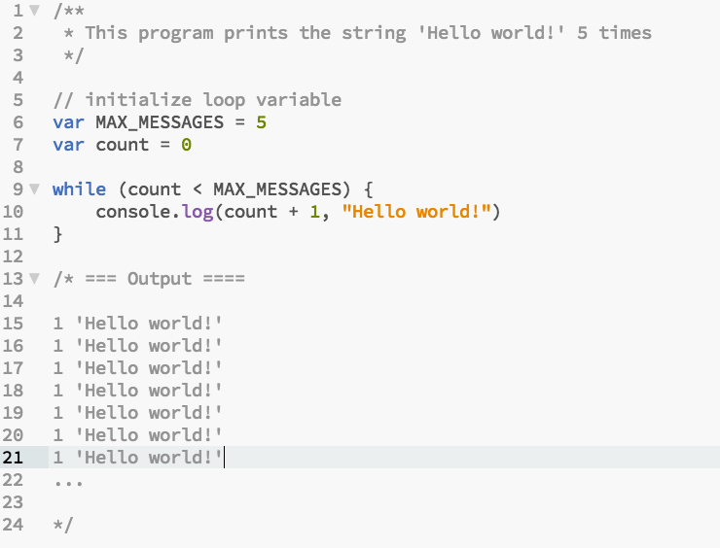
Example-01.js

Slide 131
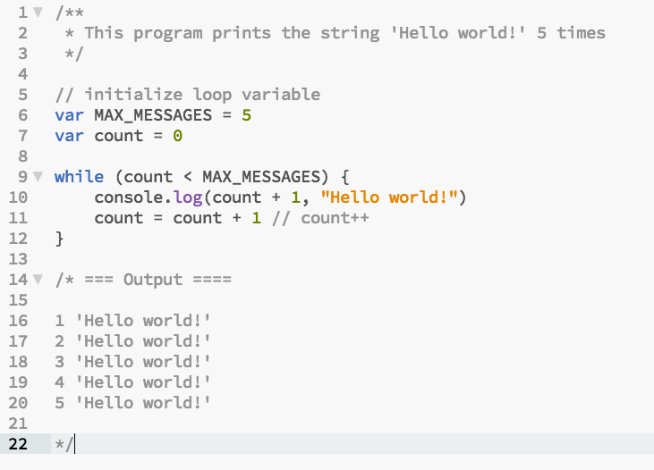
Example-02.js

Slide 132
Loop Breakdown

Slide 133
The ‘for’ Statement
Formal syntax:
for(initialization; condition; update){
Statement 1
..
Statement N
}
Where:
‘initialization’ gets executed ONLY once at the beginning of the ‘for’ loop
‘condition’ gets tested to determine if the block of statement is executed
‘update’ gets executed after block of statement

Slide 134
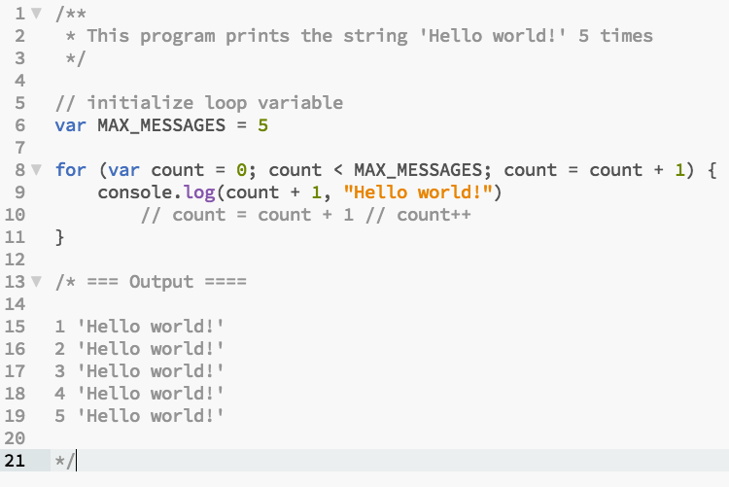
Example-03.js

Slide 135
‘for’ Loop Pitfall
Don’t update ‘for’ loop condition variable(s) multiple times in loop iteration

Slide 136
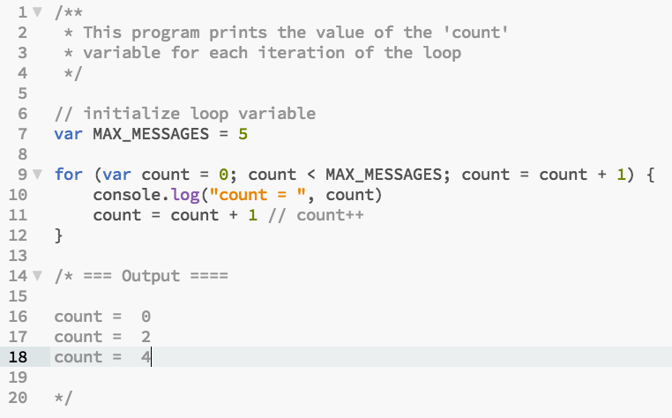
Example-04.js

Slide 137
‘for’ Loop Variation
All parts of the ‘for’ loop statement is optional
Provides flexibility in when to initialize
When to test and exit loop
When to perform condition variable(s) updates

Slide 138
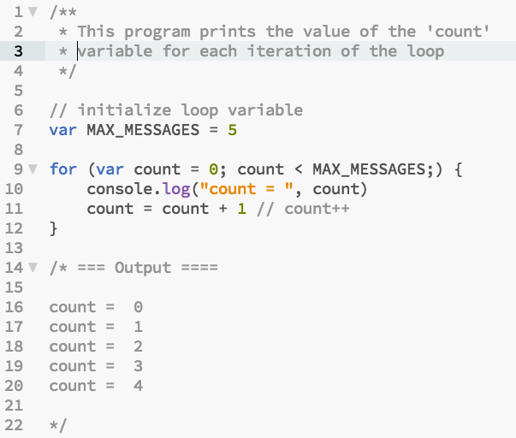
Example-05.js

Slide 139
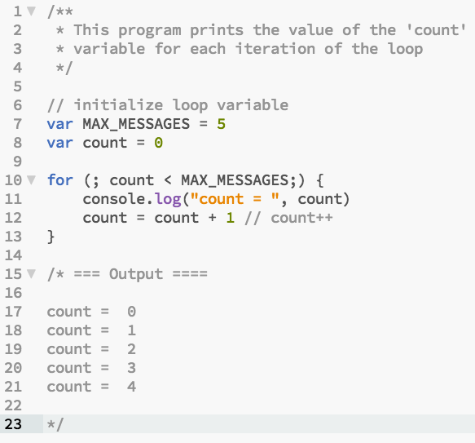
Example-06.js

Slide 140
Using ‘continue’ in Loops
The ‘continue’ keyword in a loop is used to skip one or more iteration

Slide 141
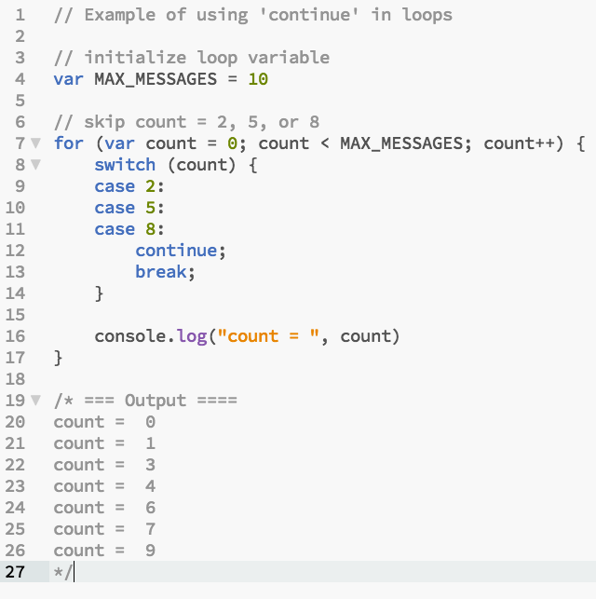
Example-07.js

Slide 142
‘infinite’ Loop
An ‘infinite’ loop is used when:
The number of iterations is not known at loop ‘initialization’
Possible an external condition will be used to ‘break’ out of the loop
Some form of complex computation will be used to ‘break’ out of the loop
The developer wishes to express the intend that this loop will not terminate

Slide 143
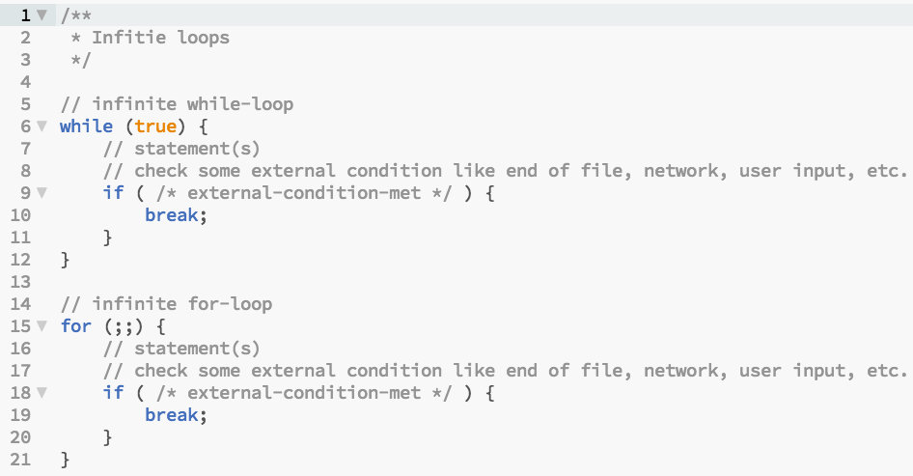
Example-08.js

Slide 144
Chapter 5 – JavaScript
#43 – Section 19
Statements and Expressions

Slide 145
Topics
Statements
Expressions
Types of Expressions
Reference:
MDN Statements and Declarations: https://developer.mozilla.org/en-US/docs/Web/JavaScript/Reference/Statements
MDN Expressions and Operators: https://developer.mozilla.org/en-US/docs/Web/JavaScript/Reference/Operators

Slide 146
Program
Program
Statement
Statement
Statement
…
Statement

Slide 147
Statement
Statement
Expression
Non-Expression
Contain Expression(s)
NOTE:
A statement can span multiple lines. For example, ‘if’ and ‘for’ statements.
Multiple statements can be on one line if separated by ‘;’.

Slide 148
Definition : Expression
What is an ‘Expression’?
Verrol’s definition:
When evaluated/computed, an expression produces a single value
Some Process
value
Expression
NOTE: An expression’s value can always be assigned to a variable.

Slide 149
Definition: Value
A value is an abstraction to represent a computed result
A variable is a named abstraction to recall or reference a value

Slide 150
Example : Expressions
Single value
5
‘verrol’
Mathematical
5 + 9
x * 20
Relational
x < 10
i > 20
Logical
(i > 20) || (x < 10)
isOpen && isValid
Bitwise
0x100FFA | 0x100B
0x3920A & 0x4
Functional
function() { … }
i++

Slide 151
Logical Operator: AND, &&
Operand 1 | Operand 2 | Result
True | True | True
True | False | False
False | True | False
False | False | False

Slide 152
Logical Operator: OR, ||
Operand 1 | Operand 2 | Result
True | True | True
True | False | True
False | True | True
False | False | False

Slide 153
Logical Operator: NOT, !
Operand | Result
True | False
False | True

Slide 154
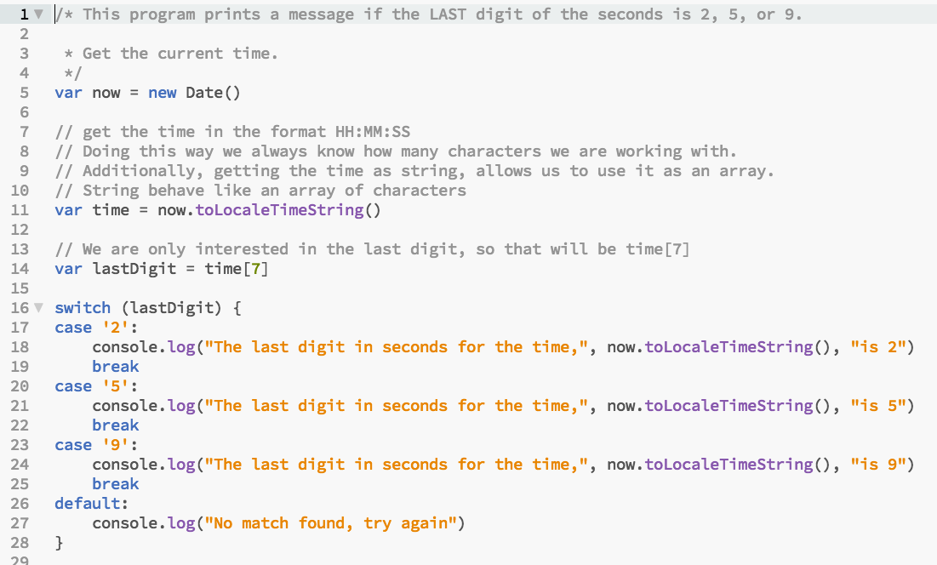
C05S17 - Example-01.js

Slide 155
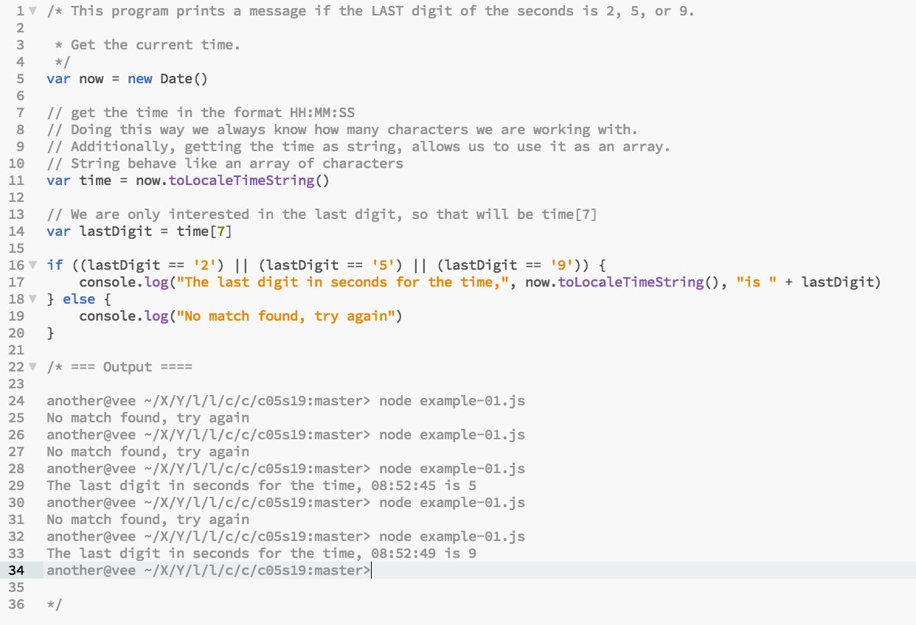
Example-01.js

Slide 156
C05S18 - Example-07.js

Slide 157
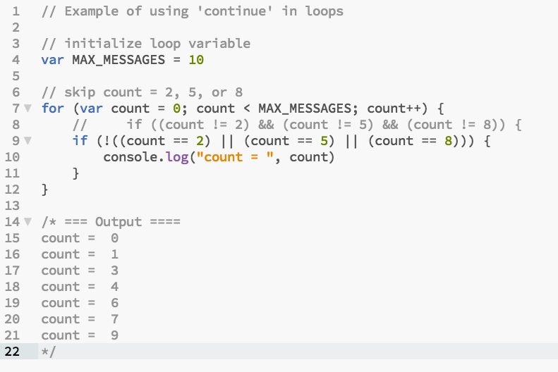
Example-02.js

Slide 158
Truth Table
Count | Count == 2 | Count == 5 | Count == 8 | ! (…) | Result
0 | F | F | F | T | T
1 | F | F | F | T | T
2 | T | - | - | F | F
3 | F | F | F | T | T
4 | F | F | F | T | T
5 | F | T | - | F | F
6 | F | F | F | T | T
7 | F | F | F | T | T
8 | F | F | T | F | F
9 | F | F | F | T | T

Slide 159
Chapter 5 – JavaScript
#44 – Section 20
Serialization With JSON

Slide 160
Topics
What is Serialization?
What is JSON
Reference:
JSON Specification: http://www.json.org/

Slide 161
Problem: Exchanging Values
How to get the value of a computation in computer A to computer B?
Computer A
channel
Computer B
NOTE: The ‘channel’ is just an abstraction for how the two computers
are connected.
Examples:
USB drive/disk
Email
CD/DVD/Tape
Network
Etc.

Slide 162
Definition : Serialization
What is ‘Serialization’?
Verrol’s definition:
A method of transforming values in computer memory to a representation suitable for computer-to-computer interchange.
Value
Format X
Value
Format A
channel
Value
Format A

Slide 163
Demo
Simple value Serialization:
Example-01.js
Nested JavaScript Object Serialization:
Example-02.js
Deserialization:
Example-03.js

Slide 164
Conclusion
Serialization, and by extension de-serialization, gives you the ability to easily transfer values from one computer to another.

Slide 165
Chapter 5 – JavaScript
#45 – Section 21
MISC: Variable Scope

Slide 166
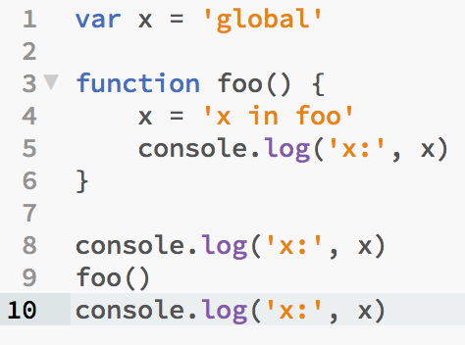
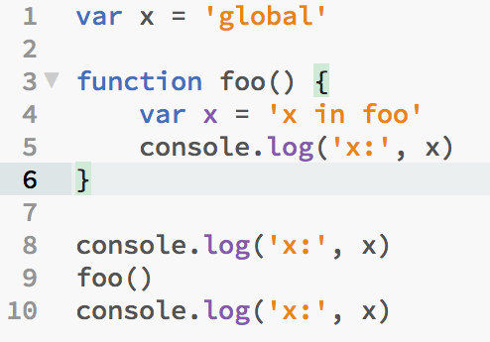
What Is Going On Here?
Example-01.js
Example-02.js
x: global
x: x in foo
x: x in foo
x: global
x: x in foo
x: global

Slide 167
Topics
Variable Scope
Global
Non-Global
Execution Context (or Environment)
Browser Client
NodeJS Application

Slide 168
Variable Scope
A ‘scope’ is a logical home for variables
Each variable below to one and only one ‘scope’
Scope can be nested, but never overlap
Variable resolution start from inner to outer/parent scope
There is always one scope present, the ‘global’ scope
Reference: http://speakingjs.com/es5/ch16.html

Slide 169
Global Scope
Always present
Contains variables (objects and properties) provided by the environment

Slide 170
JS Engine Liberation
Web Browser
NodeJS Application
JS
Engine
JS
Engine
Where is my JavaScript running?

Slide 171
Global Variables
Web Browser | NodeJS
console | console
document | __dirname
window | __filename
 | module

Slide 172
Demo
JavaScript in the browser
Example-03.html
JavaScript in NodeJS
Example-04.js
Example-05.js

Slide 173
Non-Global Scope
Scope created by a Function
Functions are first-class citizens in JavaScript
Functions are used to define Classes

Slide 174
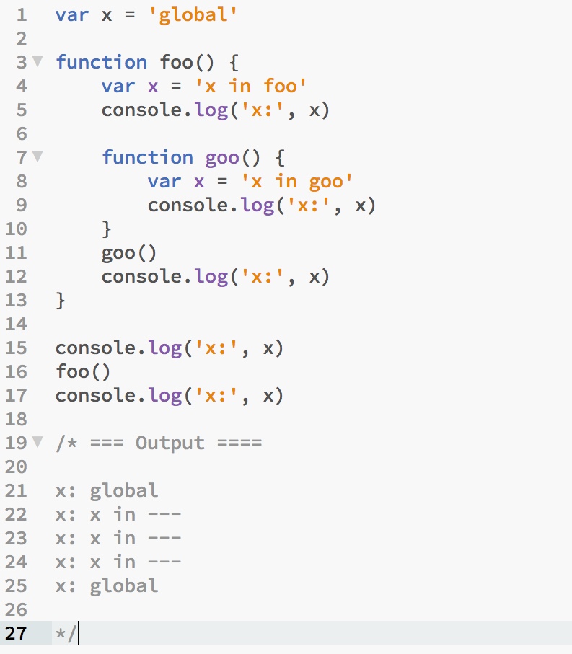
Test

Slide 175
Chapter 5 – JavaScript
#46 – Section 22
MISC: IIFE

Slide 176
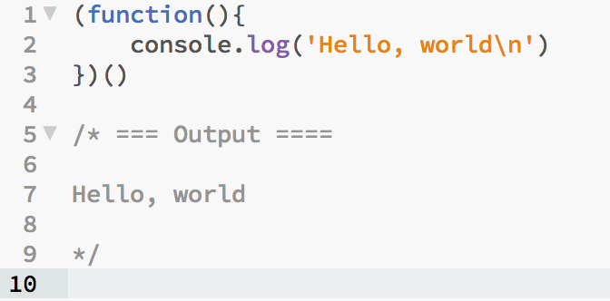
IIFE – Immediately-Invoke Function Expression
Quite simply, it is a function expression that is invoked immediately
Syntax:
(<anonymous function>)(…)
Example:

Slide 177
From Function Definition To IIFE
Example code sample 01 - 05

Slide 178
Chapter 5 – JavaScript
#47 – Section 23
MISC: Closure

Slide 179
Closure
Definition - Closure:
are functions that refer to independent (free) variables. In other words, the function defined in the closure 'remembers' the environment in which it was created.
Verrol’s Definition – Closure:
Are functions which continues to reference variables after the scope which created them expires.
JavaScript Closure - https://developer.mozilla.org/en-US/docs/Web/JavaScript/Closures

Slide 180
Illustration
Global Scope
Variables

Slide 181
Illustration
Global Scope
Variables
function foo(){
var x = 5
}
foo()
x = 5

Slide 182
Illustration
Global Scope
Variables
function foo(){
var x = 5
function goo(){
console.log(x)
}
return goo;
}
var g = foo()
x = 5
g()
x = 5

Slide 183
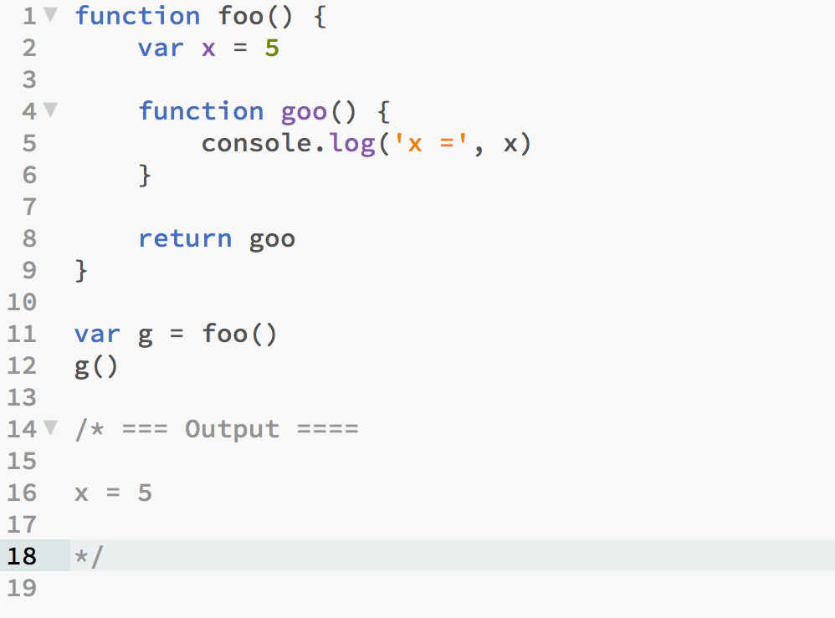
Demo – Example-01.js

Slide 184
Illustration
Global Scope
Variables
function foo(){
var x = 5
}
foo()
x = 5; reference-count = 1

Slide 185
Illustration
Global Scope
Variables
function foo(){
var x = 5
function goo(){
console.log(x)
}
return goo;
}
var g = foo()
x = 5; reference-count = 2
g()
x = 5; reference-count = 1

Slide 186
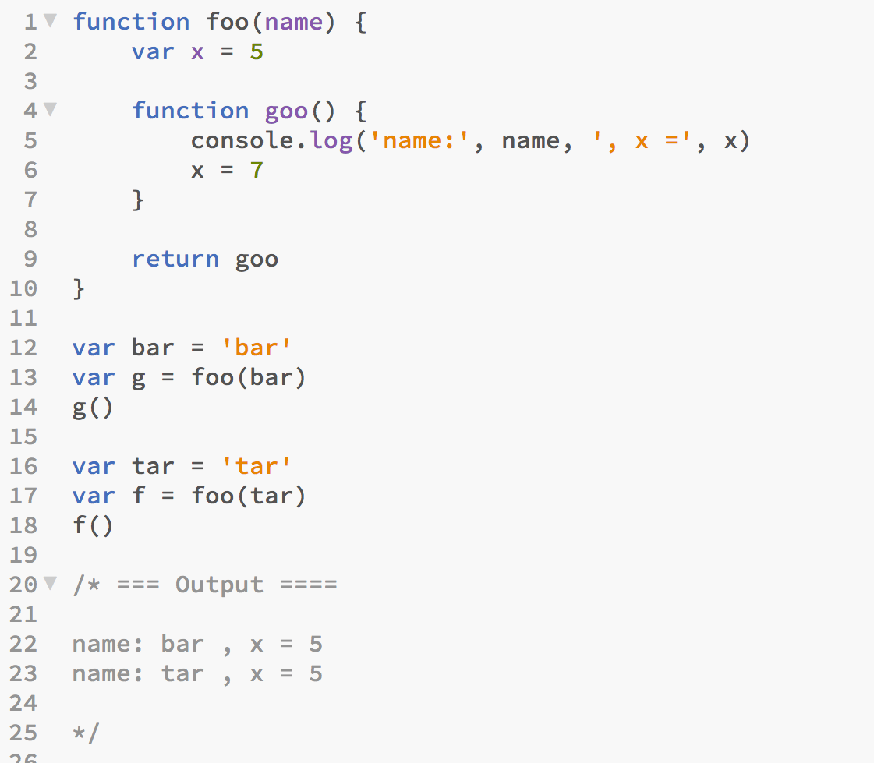
Demo – Example-02.js

Slide 187
Illustration
Global Scope
Variables
function foo(name){
var x = 5
function goo(){
console.log(‘name =‘, name, ‘, x =‘, x)
}
return goo;
}
var bar = ‘bar’
bar = ‘bar’; reference-count = 1
var g = foo(bar)
x = 5; reference-count = 2
bar = ‘bar’; reference-count = 3
g()
x = 5; reference-count = 1
bar = ‘bar’; reference-count = 2
var tar = ‘tar’
tar = ‘tar’; reference-count = 1
var f = foo(tar)
x = 5; reference-count = 2
tar = ‘tar’; reference-count = 3
f()
x = 5; reference-count = 1
tar = ‘tar’; reference-count = 2

Slide 188
Chapter 6 – AngularJS
#48 – Section 1
Up and Running with AngularJS

Slide 189
Topics
A Simple AngularJS Application
What is a AngularJS?
What is a Web Application Framework?
What is a Framework vs. Library?

Slide 190
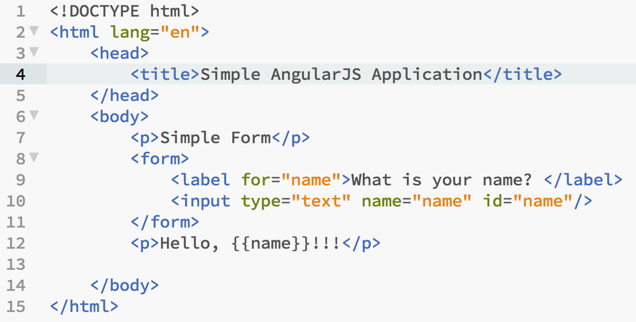
Demo – No AngularJS: Example-01.html

Slide 191
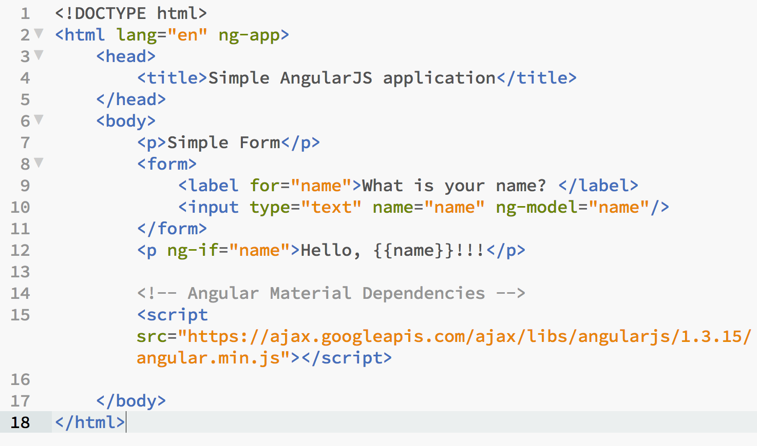
Demo – AngularJS: Example-02.html

Slide 192
What is …?
What is a AngularJS?
A web application framework used to build Single Page web Applications (SPA).
What is a Web Application Framework?
A framework provides basically two things:
collection of libraries which provides reusable code
mechanism to call your code at key points of its life-cycle
What is a Framework vs. Library?
Libraries are a collection of classes and methods intended for reuse.
Your code uses or is built on one or more libraries.
Hence, libraries don’t implement life-cycle
What is are SPAs?
A way of constructing web applications that makes them more responsive and relies heavily on RESTful APIs.

Slide 193
Framework vs. Library Illustrated
Application
Application
Life Cycle
Management
liba
libb
libc
liba
libb

Slide 194
Framework/Library :Pros vs. Cons
 | Framework | Library
Pros | Less to do, hence faster to create finished product | More flexibility
Cons | Very authoritative, less flexibility Can be invasive | Don’t do most of the heavy lifting

Slide 195
Chapter 6 – AngularJS
#49 – Section 2
Using ‘Simple’ Directives

Slide 196
Topics
What is an AngularJS Directive?
“Some” Examples of Using Directives?

Slide 197
What is an AngularJS Directive?
Broadly speaking:
Directives are used to generate or manipulate HTML
Directives fall into one or more of the following four(4) categories:
Attribute
Element
CSS (Cascading Style Sheet) Class
Comment
Ref: AngularJS Directives Doc - https://docs.angularjs.org/api/ng/directive

Slide 198
Examples of Directives
Attribute
<p ng-if=“…”>...</p>
<dir ng-repeat=“...”>...</dir>
Element
<a-name>...</a-name>
<my-dir>...</my-dir>
Class
<span class=“my-dir: exp;”></span>
Comment
<!-- directive: my-dir … -->
<!– directive: a-name … -->

Slide 199
MVC – Software Architecture
MVC is the acronym typically given to a specific way of organizing application software.
MVC : Model-View-Controller
Model: Abstraction of the application’s data
View: How the data is presented
Controller: Logic that acts as the ‘control’ between Model and View

Slide 200
Demo
Ng-Model
Example-01.html
Ng-If
Eample-02.html
Section 3 Teaser
Example-03.html

Slide 201
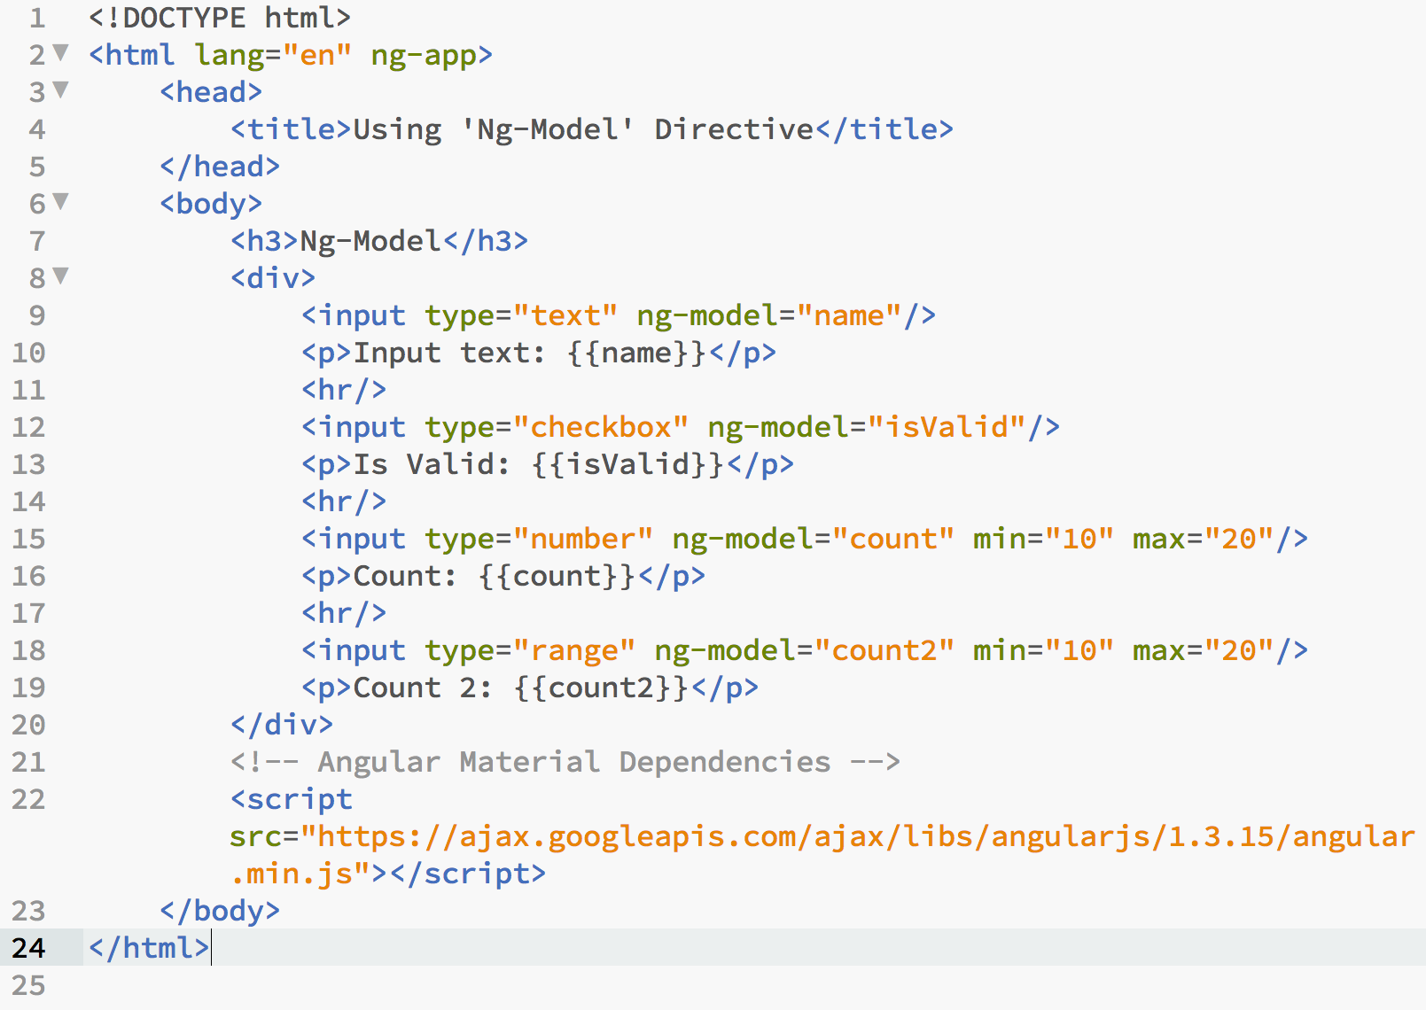
Example-01.html

Slide 202
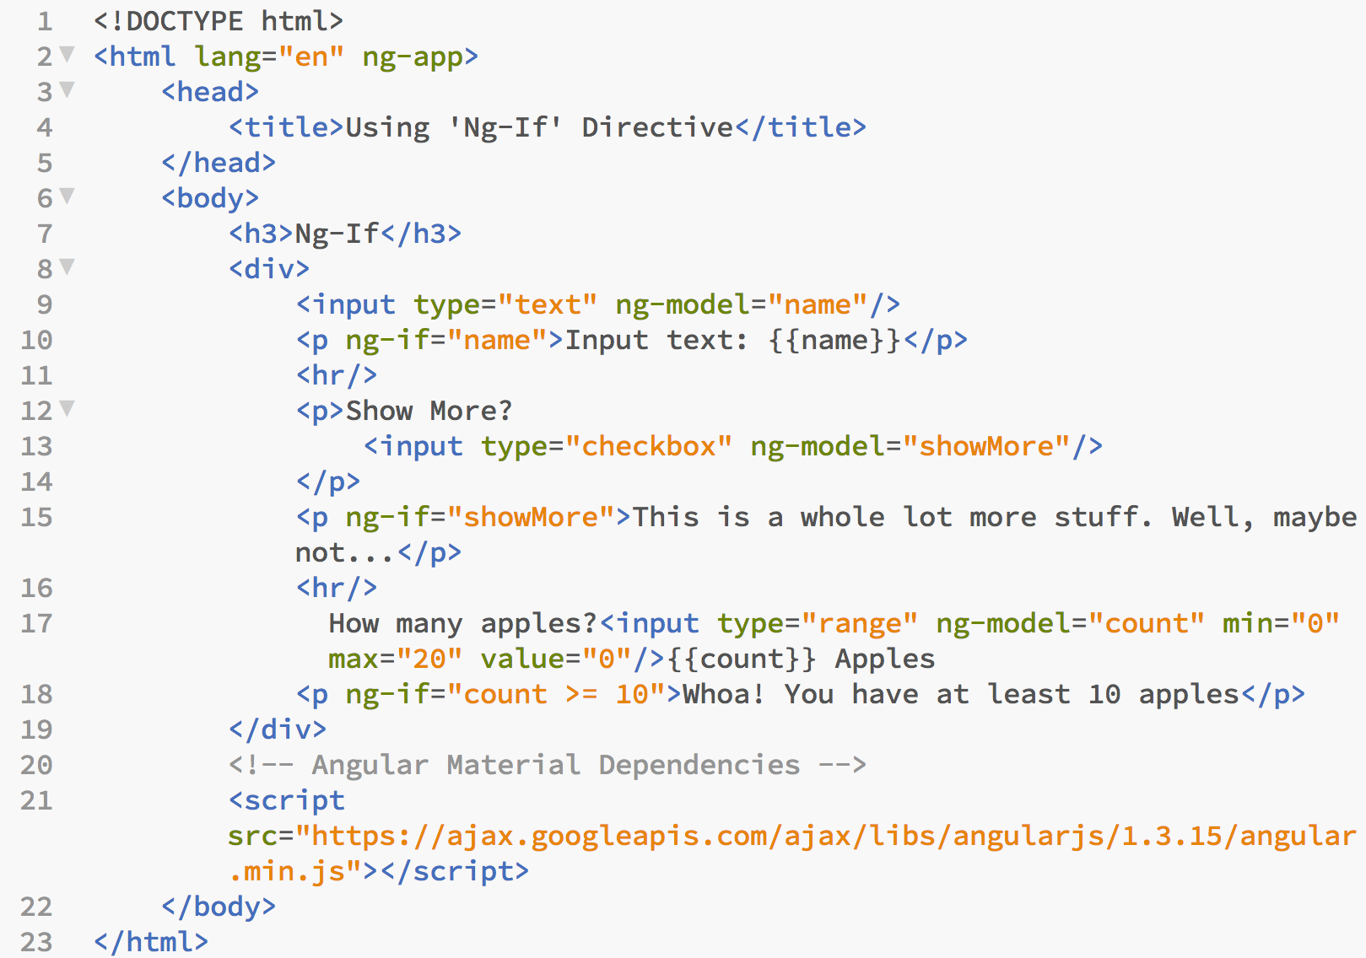
Example-02.html

Slide 203
Chapter 6 – AngularJS
#50 – Section 3
Controller – The C in MVC

Slide 204
Topics
What is a Controller?
How are Controllers used in Angular?
Examples of using Controllers in Angular

Slide 205
What is a Controller?
Broadly speaking:
Controllers are used to coordinate the [user’s] interaction between the View and the Model.
AngularJS uses a template to render a View
A template is HTML with additional markup for model data substitution and other useful constructs.

Slide 206
MVC : Model-View-Controller
View
Controller
Model (data)

Slide 207
AngularJS Controller
Acts as a bridge between the View and the Model
It provides the View with the appropriate data
It handles requests for data and manipulation of the data
AngularJS uses the $scope variable to bind Model and View

Slide 208
$scope
The $scope is simply a JavaScript Object.
View
$scope
Controller
name: ‘verrol’
<div ng-controller=“MyController”>
<h1>Hello, {{name}}!</h1>
</div>
function MyController($scope){
$scope.name = ‘verrol’
}
Ref: AngularJS Directives Doc - https://docs.angularjs.org/guide/scope

Slide 209
Demos
Example-01.html – Simple Angular Controller
Example-02.html – The Effect of Scope
Example-03.html – Nested Scope
Example-04.html – Multiple Variables
Example-05.html – Ng-Repeat
Example-05.html – Using $interval and dateFilter

Slide 210
Chapter 6 – AngularJS
#51 – Section 4
Diving Deeper

Slide 211
Topics
Introducing A Few More Directives
Defining Event Handlers In Controllers
Application Demo: ToDo Web App

Slide 212
Introducing A Few More Directives
So far, we have used the following:
ng-app, ng-model, ng-if, ng-repeat, ng-controller
Now it is time to try a few more:
ng-show, ng-hide, ng-click, ng-disabled

Slide 213
Defining Event Handlers In Controller
In addition to making data available to the View as Model, the controller handles user interaction with the view.
For example when a user:
Clicks a UI element to show more data
Clicks a UI element to remove data
Wants to navigate to another view/page
Clicks a button to submit new data
…

Slide 214
Event Handlers
An event handler is a function that is invoked for a specific event.
There are many types of events. The source of the event may be either user or system generated.
For example:
An event can be users generated, as in a user clicking a button or moving their mouse over a particular area.
An event may come from the system, such as a periodic timer or data arriving into the system.

Slide 215
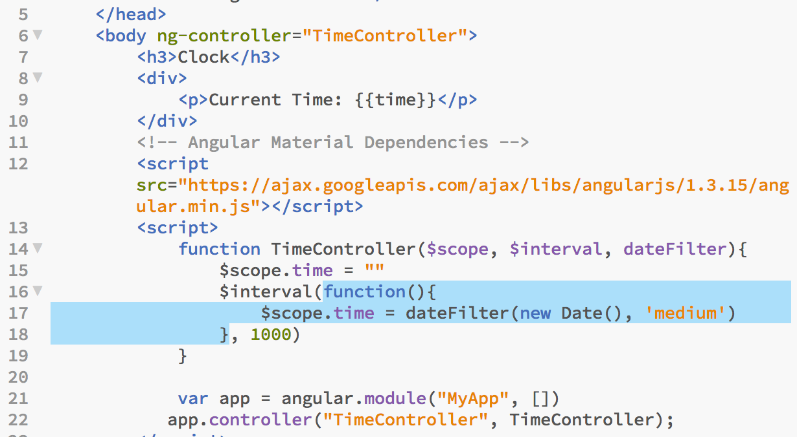
Example: Non-User/System Event

Slide 216
Demo : To-Do Application
A step-by-step development of a ‘simple’ To-Do Application
Requirements:
Display a list of tasks to accomplish, hence To-Do
Add task
Remove unwanted task

Slide 217
Chapter 6 – AngularJS
#52 – Section 5
Enhancing To-Do App

Slide 218
Topics
Enhance To-Do Web App
Add a few more features to the app
Introduce a few more directives
Review Of AngularJS Components

Slide 219
To-Do Application
A step-by-step development of a ‘simple’ To-Do Application
Requirements:
Edit Task Title
Modify Task Progress
Add Task Description

Slide 220
Review
So far, we have covered/used the following Angular components:
Module
Directives
Controller
View/Template
Model (just JavaScript data types)

Slide 221
Chapter 6 – AngularJS
#53 – Section 6
More To-Do Enhancements

Slide 222
Topics
Fix Annoying UI Issues
Editing updates list entry
Simple task completion
Filtering
Hide/Show completed task
Search

Slide 223
Chapter 6 – AngularJS
#54 – Section 7
Multiple Views & Routing

Slide 224
Topics
Loading Multiple Pages
The Old Way
The New Way – Single Page Applications
Routes

Slide 225
Loading Multiple Pages: The Old Way
Linking pages with the hyperlink tag, ‘a’:
<a href=“url”>Text</a>
Demo

Slide 226
Loading Multiple Pages: The NewWay
Multiple ‘Views’ with the hyperlink, buttons, or any event
Demo

Slide 227
MVC : Model-View-Controller
View
$scope
Controller
Model (data)

Slide 228
Multiple Views
View (listing)
View (edit)
Controller
Controller
Model (data)

Slide 229
Multiple Views
Browser-listing
Mobile-listing
View
View (edit)
Controller
Controller
Model (data)

Slide 230
Routes
Route (listing)
Route (edit)
View
View
Controller
Controller
Model (data)

Slide 231
Conclusion
Loading Multiple Pages
The Old Way
The New Way – Single Page Applications
Routes
On The Next Episode
Services

Slide 232
Chapter 6 – AngularJS
#55 – Section 8
URL and Route Params

Slide 233
Topics
What is an URL
URL Path
URL Params
AngularJS Route Params
Dynamic Routes

Slide 234
What is an URL?
URL stands for Universal Resource Locator
Simply put, it is locator, a.k.a location identifier, for a resource (anything hosted on a server). The universal parts comes into play by the fact that part of the URL contains the IP address or Hostname is unique.
Partial Standard Format of an URL:
[protocol://]
host
[:port]
[/path]
[?params]

Slide 235
URL Path
The URL Path looks like a file path on your computer
It is a specification for the location of the resource on the Web Server
The URL Path is every that comes after the host and port, but before the params.
[protocol://]
host
[:port]
[/path]

Slide 236
Examples Of URL Paths
Using Default Port 80:
http://localhost
GET ‘index.html’ at the ‘web root’ or ‘/’
http://localhost/file.html
GET ‘file.html’ at the ‘web root’ or ‘/’
Using Customer Port 8000:
http://localhost:8000
GET ‘index.html’ at the ‘web root’ or ‘/’
http://localhost:8000/file.html
GET ‘file.html’ at the ‘web root’ or ‘/’
http://localhost:8000/article
GET ‘index.html’ in ‘/article’
http://localhost:8000/post
GET ‘index.html’ in ‘/post’
NOTE: Directory listing of ‘/post’ if there is no ‘index.html’
http://localhost:8000/post/post1.html
GET ‘post1.html’ in ‘/post’

Slide 237
URL Parameter
URL Parameters is a simple way of passing additional data in a web request.
Often called URL params for short.
Parameters are specified ask a set of key/value pairs starting after “?” and separated by “&”
Examples:
Simple GET request, no params:
http://localhost:8000
GET request with param ‘q’:
http://localhost:8000?q=angularjs
This request sends the additional key/value pair ‘q’ and ‘angularjs’ respectively.
http://localhost:8000?q=angularjs%20tutorial
Key/value => ‘q’ and ‘angularjs tutorial’
‘%20’ means a space character
GET request with params ‘q’ and ‘rct’
http://www.google.com?q=angularjs&rct=j
& is used as separator between key/value params pairs
[protocol://]
host
[:port]
[/path]
[?params]

Slide 238
Examples Of Paths and Params
Paths without params:
GET ‘index.html’ at the ‘web root’ or ‘/’:
http://localhost:8000
GET ‘index.html’ in ‘/post’:
http://localhost:8080/post
GET ‘article-01.html’ in ‘/post’:
http://localhost:8000/post/article-01.html
Paths with params:
http://localhost:8000/post/2016?m=6&t=plain
http://localhost:8000/post/2016/article-01.html?f=json

Slide 239
Route Params
A mechanism to provide URL params to route controller
In AngularJS, the params are provided a JavaScript Object
Where each param name/key is a key in the object
AngularJS support dynamic routes
Routes that follow a specified format
The dynamic part of the route is part of the params
AngularJS, and most SPA frameworks, Route:
[[protocol://]
host
[:port]
[/path]
#[route]
[?params]

Slide 240
Examples of Route Params
Static Route and Params
#/?q=test
Route: ‘/’, params: {q=test}
/user?id=5
Route: ‘/user’, params: {id = 5}
/user?id=1&op=edit
Route: ‘/user’, params: {id = 5, op = edit}
Dynamic routes:
#/user/1
Route: ‘/user/:id’, params: {id = 1}
NOTE valid routes are: ‘/user/2’, ‘/user/X’, ‘/user/bobby’, etc.
/user/1/edit
Route: ‘/user/:id/:action’, params: {id=1, action=edit}
NOTE valid routes are: ‘/user/5/print’, ‘/user/bobby/delete’, etc.
/user/1/edit
Route: ‘/user/:id/edit’, params: {id=1}
Routes with key/value pairs:
/post/economy?y=2016&m=6&d=5
Route: ‘/post/:category’, params: {category = economy, y = 2016, m = 6, d = 5}

Slide 241
Chapter 6 – AngularJS
#56 – Section 9
AngularJS Root Scope

Slide 242
Topics
Problem: Sharing Data Across Routes
Introducing ‘$rootScope’

Slide 243
Problem
An application with the following routes:
/
List all ‘items’
/new
Provides a form to create a new ‘item’
/edit/:id
Provides a form to edit and update an ‘item’

Slide 244
MVC – In Theory
Listing Route (/)
New Route (/new)
Edit Route (/edit/:id)
View
View
View
Controller
Controller
Controller
Model (data)

Slide 245
MVC – ‘So Far’
Listing Route (/)
New Route (/new)
Edit Route (/edit/:id)
View
View
View
Controller
Controller
Controller

Slide 246
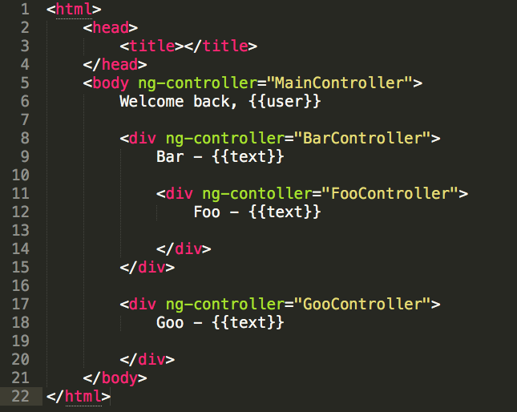
Nested Scopes

Slide 247
Nested Scope - Tree View
main
bar
goo
foo

Slide 248
Nested Scope - Tree View
main
listing
new
edit

Slide 249
Routes
Listing Route (/)
New Route (/new)
Edit Route (/edit/:id)
View
View
View
Controller
Controller
Controller
Controller

Slide 250
Root Scope
index
MainController
$scope
listing
$scope
ListController
edit
$scope
NewController
edit
$scope
EditController

Slide 251
Root Scope
$rootScope
index
MainController
$scope
listing
$scope
ListController
edit
$scope
NewController
edit
$scope
EditController

Slide 252
Root Scope : $rootScope
Scope In AngularJS can be nested
Each scope, has a parent scope
Except the top-most scope, the root scope ‘$rootScope’
The root scope, ‘$rootScope’, is always avaliable

Slide 253
Conclusion
Scopes are nested
The root scope, $rootScope, is the parent of all scopes
Don’t abuse the root scope

Slide 254
Chapter 6 – AngularJS
#57 – Section 10
AngularJS Service

Slide 255
Topics
Problem: Reusing Business Logic
Introducing AngularJS Service
Upgrading ToDo App

Slide 256
MVC – with Routes
Listing Route (/)
New Route (/new)
Edit Route (/edit/:id)
View
View
View
Controller
Controller
Controller
Model (data)

Slide 257
MVC – In Practice
Listing Route (/)
New Route (/new)
Edit Route (/edit/:id)
View
View
View
Controller
Controller
Controller
Model (data)
files
SQL-DB
nonSQL-DB
Persistence Store

Slide 258
Application Architecture
Listing Route (/)
New Route (/new)
Edit Route (/edit/:id)
View
View
View
Controller
Controller
Controller
Service
Service
Model (data)

Slide 259
Service : Benefits
Provides a place for reusable business logic
Provides persistence across Controllers
A new instance of a Controller is created each time the route is refreshed or visited
A new instance of a Service is created once for the live of the application
Provides a ‘sensible’ point of control for access to the Model’s data
Makes it easier to enforce data integrity at the application layer

Slide 260
Conclusion
Key points to remember about services:
They get instantiated once
Meaning that the same service is shared across all controllers which injects it
The implementation is a function that returns an object
The object usually contain keys whose values are functions

Slide 261
Chapter 6 – AngularJS
#58 – Section 11
Adding Routes and Service to Simple AngularJS To-Do Application

Slide 262
Topics
ToDo Application Enhancement
Add Routes for ‘/’(listing), ‘/new’, and ‘/edit’
Use a Service for Data Manipulation
newTask()
addTask()
getAllTasks()
getTaskById()
updateTaskById()
removeTaskById()

Slide 263
Updating Data By Id
Without Id
With Id
Task
Task
title
id
status
title
description
status
…
description
…
update ‘title’
Update ‘title’
Task
title
Task
status
id
description
title
…
Sends both changed and unchanged fields
Sends only what needs to be updated

Slide 264
‘id’ vs ‘index’
Why the unique ‘id’ is much better than using the array index:
Your objects don’t have to be in an array
It can be in any type of collection including hash/dictionary
Very problematic in multi-user applications:
The location in the array may change as other users add/remove objects
Easier to decouple front-end from back-end/server

Slide 265
Conclusion
ToDo app is:
More robust
Easier to add advance capabilities
Multiple user support
Remote storage

Slide 266
Chapter 6 – AngularJS
#59 – Section 12
ToDo App Enhancement

Slide 267
Topics
ToDo Application Enhancement
Add ‘cancel’ button to new and edit forms
Move delete from listing to edit form
Delete action should ask for confirmation

Slide 268
Chapter 6 – AngularJS
#60– Section 13
Angular Event Passing Using $broadcast and $on

Slide 269
Topics
Using Angular $broadcast and $on
Simple Multi-User Application
ToDo Application Enhancement
Only Admin User can create account
User can login
User sees only the tasks they create
Admin users see all the tasks for all users
Admin users can manage user accounts

Slide 270
ToDo Application Navigation
login
/
/new
Login
Add Todo
/user/list
Users
logout
Logout
/user/new
Users

Slide 271
Chapter 6 – AngularJS
#60– Section 14
Angular – Using Controller Alias

Slide 272
Topics
Using Angular Controller Alias
Using “as” in ng-controller Directive
Using ‘controllerAs’ in Route Definition
More ToDo Cleanup
No new feature, just code refactoring

Slide 273
Nested Scopes

Slide 274
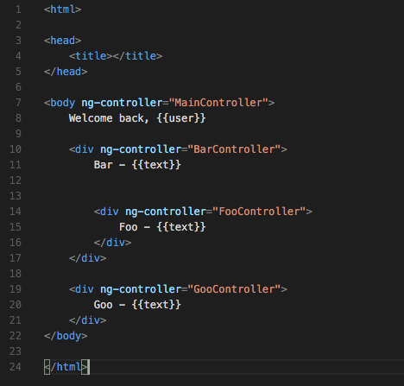
Controller Without “as”

Slide 275
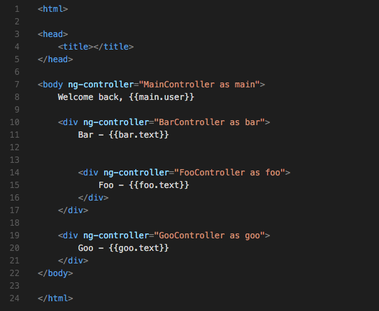
Controller With “as”

Slide 276
Chapter 6 – AngularJS
#61 – Section 15
AngularJS - RESTful Request - GET

Slide 277
Topics
What is a Server?
What is a Client?
Web Server and Browser Communication
What is HTTP?

Slide 278
Server & Client
Broadly speaking:
Server : provides one or more services a client needs
Client : makes requests to a server to use a provided service
Example:
Service – a business providing any number of services
Car wash
Restaurant
Client – typically a customer

Slide 279
Server & Client Interaction
Service A
Service B
client
Service C
server

Slide 280

Computer Server & Client

Slide 281
Web Browser
Web Browser
HTML
CSS
a.html
JS
Engine
b.css
c.js

Slide 282
Example Page Request
Get ‘index.html’
index.html
here it is
app.css
Web browser
app.js
Web server

Slide 283
Web Browser & Web Server
Web Browser
HTTP/Web Server
Request:
GET ‘/a.js’
1
4
Response:
function foo(){
…
}
3
2
JS
Engine
a.js
b.js
index.html

Slide 284
HTTP: Communication On The Web
HTTP – Hypertext Transport Protocol
Protocol – The rules for communication
The two parties communicating are:
Client : The web browser (or HTTP client)
Server: The web server (or HTTP server)
HTTP is simple
Made up of REQUEST/RESPONSE
Client makes REQUEST
Server sends RESPONSE to client REQUEST
NOTE: The sever ‘never’ initiates an exchange

Slide 285
Demo: GET Request
Objective:
Demonstrate Browser Client Request To Server
Demonstrate Server Response
Server can’t serve files it doesn’t have
Server respond with requested file

Slide 286
Chapter 7 – NPM, Bower, and Yeoman
#65 – Section 1
Getting Started with NPM

Slide 287
Objective
Describe what a NodeJS Module (aka package) is
Demonstrate a simple NodeJS application using the a JSON file reader/writer package
app.js – contains NodeJS application code in JavaScript
pata.json – contains some sample data for the app to read and display on the console
package.json – NPM file to manage application dependencies

Slide 288
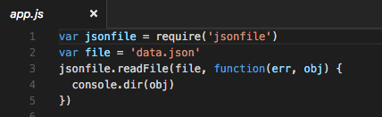
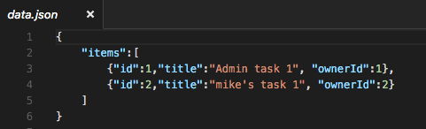
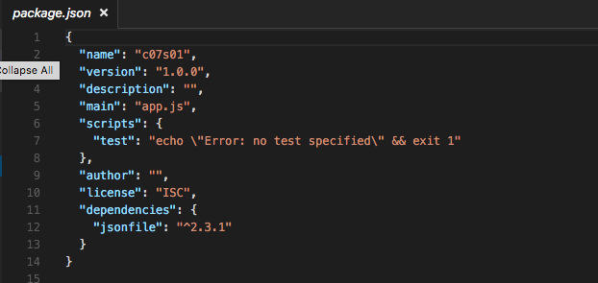

Demo : Read JSON File

Slide 289
Chapter 7 – NPM, Bower, and Yeoman
#66 – Section 2
Writing a Simple Web Server in NodeJS

Slide 290
What Does A Web Server Do?
Simple – Handle Requests
Web server can fulfill the request
Web server can delegate request
Web server can forward request
Web server can redirect request
Web server can reject request

Slide 291
What Do Web Clients Do?
Make Requests
Web clients initiates a request
Clients can send different kinds of requests
GET, POST, UPDATE, DELETE, and more
Handle Responses

Slide 292
Let’s Make a (simple) Web Server
Objective:
Sends the message ‘hello, world’ to each connected client that connects
Ref: NodeJS Usage Example: https://nodejs.org/dist/latest-v4.x/docs/api/synopsis.html

Slide 293


Demo : Simple Web Server 01
(req, res) => {
…
}
function(req, res) {
…
}

Slide 294

Demo : Simple Web Server 02

Slide 295

How to test with ‘curl’
Curl:
$ curl <url>
$ curl <url> -X ‘METHOD’
Where METHOD is one of GET, PUT, POST, DELETE, OPTIONS

Slide 296

How to test with ‘telnet’
$ telnet localhost 3000
<METHOD> <path> HTTP/1.1
<HEADER-NAME>: <VALUE>

Slide 297
Chapter 7 – NPM, Bower, and Yeoman
#67 – Section 3
Writing a Simple API Server in NodeJS

Slide 298
Objective
Create a simple RESTful API (HTTP web server)
Accepts JSON in a POST request
Response to GET requests with JSON array
Only support GET and POST to ‘/api/tasks’ endpoint

Slide 299
Putting It Together
Demo – app01.js
Starting point, prints request info:
PATH, METHOD, and HEADERS
Demo – app02.js
How to read request body
Using NodeJS stream module’s
Demo – app03.js
API server implemenation

Slide 300

Demo – app01.js

Slide 301

Test – app01.js

Slide 302

Demo – app02.js

Slide 303


Slide 304

Test – app02.js

Slide 305
Video Demo

Slide 306

Demo – app03.js

Slide 307


Slide 308


Slide 309


Slide 310
Chapter 7 – NPM, Bower, and Yeoman
#68 – Section 4
Client & Server - Together at last

Slide 311
Objective
Connect client app (front-end) to api server (back-end)
Modify api server to:
Support POST/GET/PUT requests for User
User endpoint is at ‘/api/v1/user’
SECURITY
Prevent bad actors from adding, editing, or deleting users and tasks

Slide 312
Benefits of API Versioning
Why include the version in the API PATH?
Obvious to users the API immediately without reading docs
No need to add ‘version’ property to each request
API server doesn’t need to check version
Makes adding incompatible changes manageable
Makes depreciating or end-of-life API manageable

Slide 313
Version Support Illustration
 | Client v1 | Client v2 | Client v3
API Server v1 | ✔ | − | −
API Server v2 | ✔ | ✔ | −
API Server v3 | ✗ | ✔ | ✔
Legend:
✔: fully supported
− : unsupported, not implemented
✗ : no longer supported, old version

Slide 314
Security Concerns (some)
Unprotected RESTful API can:
allow DOS attacks
DOS (Denial of Service) by flooding the server with requests
Also need throttling/rate-limiting to mitigate attack
Allows bad actors to corrupt data
Allows unauthorized access to data

Slide 315

Project Structure

Slide 316
Project Setup
Combine client and server into under one directory, c07s04
Copy c06s15/todo -> c07s04/client
Copy c06s15/api/tasks.json -> c07s04/server/db/tasks.json
Copy c07s03/appX.js -> c07s04/server/
c07s04/server/app01.js : implements /api/v1/user

Slide 317
About The Code
Implement endpoint for /api/v1/user
Handle POST, GET, PUT, and DELETE
Security Consideration
Not handled, but very important
DOS attack
Unauthorized users
Separate Front-end and Back-end Servers
Cross site Script/Cross Origin Resource Sharing
Handling OPTIONS header

Slide 318
Scenario 1: Application Servers API & Client
Web Server
Client 1
n
Client 2
n
AppX
AppX
API
(backend)
API
(backend)
Client 3
Client
(frontend)
Client
(frontend)

Slide 319
Scenario 1: (Continue…)
Web Server
Client 2
n
Client
(frontend)
n
AppX
AppX
API
(backend)
API
(backend)
Client
(frontend)
Client
(frontend)

Slide 320
Scenario 1: (Continue…)
Web Server
Client 2
Client
(frontend)
n
n
AppX
AppX
API
(backend)
API
(backend)
Client
(frontend)
Client
(frontend)

Slide 321
An Ideal Request/Response Cycle
AngularJS
Browser
Server
$http.post()
REQ[POST]
RESP{}
.success(…)

Slide 322
Scenario 2: Separate Client & API Servers
Web Server
n
Client AppX
Client 1
(frontend)
Client 2
Client 3
Web Server
q
API X
(backend)

Slide 323
Scenario 2: (Continue…)
Web Server
n
Client AppX
(frontend)
Client 2
Client
(frontend)
Web Server
q
API X
(backend)

Slide 324
CSR/CORS
AngularJS
Browser
Server
$http.post()
REQ[OPTIONS]
RESP{Allow-*}
REQ[POST]
RESP{}
.success(…)

Slide 325
Scenario 2: (Continue…)
Web Server
n
Client AppX
(frontend)
BAD Client
Fake
(frontend)
Web Server
q
API X
(backend)

Slide 326

Running Client & API Backend

Slide 327
Commands
Terminal 1: Front-end Web Server:
In the ‘client’ directory:
> python –m SimpleHTTPServer 8003
Terminal 2: Back-end API Server:
In the ‘server’ directory:
> node app01.js
Terminal 3: API Requests Using ‘curl’
Create ‘admin’ user:
> curl –X ‘POST’ http://localhost:3000/api/v1/user -d ‘{“username”:”admin”, “password”:”admin”, “admin”:true}’

Slide 328

Testing: Creating A User

Slide 329

Testing: Getting All Users

Slide 330

The Front-end Changes

Slide 331

Front-end: getAllUsers()

Slide 332

Front-end: addUser()

Slide 333

Front-end: removeUser()

Slide 334

Front-end: updateUser()

Slide 335

Front-end: login()

Slide 336

Backend

Slide 337

Backend: Routing Endpoints

Slide 338

Backend: handleUserEndpoint()

Slide 339

Backend: handleDeleteUser()

Slide 340

Backend: handleCreateUser()

Slide 341

Backend: handleGetAllUsers()

Slide 342

Backend: login()

Slide 343
Chapter 7 – NPM, Bower, and Yeoman
#69 – Section 5
Client & Server – Together at last (part 2)

Slide 344
Objective
Implement Task endpoint for ‘/api/v1/task’
SECURITY
Very little to no security
$ git clone https://github.com/xiliax/web-programming-fundamentals.git
Click here: https://github.com/xiliax/web-programming-fundamentals

Slide 345

Running the Application

Slide 346

Creating User and Tasks

Slide 347

Code Snippet

Slide 348
Chapter 7 : NPM, Bower, and Yoeman
70
Section 6 - Using NodeJS Modules

Slide 349
Objective
What is a NodeJS module?
Why use modules?
Module in practice
Refactor api server (back-end) in modules
$ git clone https://github.com/xiliax/web-programming-fundamentals.git
Click here: https://github.com/xiliax/web-programming-fundamentals

Slide 350
What is a NodeJS Module?
Broadly speaking:
A module is a per file breakdown of your code
Where each file contains related functions, objects, variables, etc.
A module may be used to capture re-usage code
Which get used multiple times in the same app or in different applications.

Slide 351
Why use Modules?
Some reasons to use modules:
Organize your code and thought
Factor out commonality, similar to a function being re-usable
Mechanism to share code with others
Allow for scalable and concurrent development

Slide 352


Example - 00

Slide 353

Example-01 – Possible Module

Slide 354

Example-01 (not working)
NodeJS Module Doc: https://nodejs.org/api/modules.html#modules_modules

Slide 355

Sample NodeJS Module

Slide 356


Example - 02

Slide 357


Example - 03

Slide 358

Module with Initialization Function

Slide 359
Refactored ToDo API Server
Breakdown
Endpoints
Authentication Module (auth-service.js)
User Management Module (user-service.js)
Task Management Module (task-service.js)
Storage
User Db (user-db.js)
Task Db (task-db.js)
Core/Glue
Logging (logger.js)
Utility functions (utils.js)
Main API Server (app.js)

Slide 360
Application Architecture
Main App
Task Service
User Service
Task Service
User DB
Task DB
Core (Utils/Logging)

Slide 361

Code Snippet (User DB vs Task Db)

Slide 362

Code Snippet (User Service vs Task Service)

Slide 363
Chapter 7 : NPM, Bower, and Yoeman
Section 7 – Bower : Client Package Manager

Slide 364
Objective
What is Bower?
Using Bower to Install Client Library
Install and manger AngularJS dependency
Refactor Client app to use Bower modules
$ git clone https://github.com/xiliax/web-programming-fundamentals.git
Click here: https://github.com/xiliax/web-programming-fundamentals

Slide 365
What is Bower?
From Bower’s website (http://bower.io):
Web sites are made of lots of things — frameworks, libraries, assets, and utilities. Bower manages all these things for you.
Stated another way, use Bower to manage the libraries, frameworks, etc. for you web sites/applications.

Slide 366
Using Bower*
Installing Bower:
$ npm install –g bower
NOTE: See here if you get permission issues**
Installing Packages:
$ bower install <package>
Example, installing AngularJS Framework:
$ bower install angularjs --save
Using installed package(s):
<script src=“bower_modules/[package]/…/<package>.js>
</script>
* Docs and examples: https://bower.io/
** Fixing NPM permission issues: https://docs.npmjs.com/getting-started/fixing-npm-permissions

Slide 367

Installing and using Bower

Slide 368

Creating bower.json File
Type ‘y’ and
enter

Slide 369

Content of bower.json File

Slide 370

Install AngularJS and Save Dep.

Slide 371

Content of bower.json File

Slide 372

Benefits of bower.json File

Slide 373

Using Angular Package

Slide 374

Refactor ToDo App

Slide 375
Chapter 7 : NPM, Bower, and Yoeman
Section 8 – ExpressJS : WebApp Framework

Slide 376
Objective
What is a WebApp Framework?
What is ExpressJS?
Using ExpressJS to Build a Simple WebApp
Refactor Server App to use ExpressJS
$ git clone https://github.com/xiliax/web-programming-fundamentals.git
Click here: https://github.com/xiliax/web-programming-fundamentals

Slide 377
What is an WebApp Framework?
A web framework (WF) or web application framework (WAF) is a software framework that is designed to support the development of web applications including web services, web resources and web APIs. Web frameworks aim to alleviate the overhead associated with common activities performed in web development. For example, many web frameworks provide libraries for database access, templating frameworks and session management, and they often promote code reuse.^{[1]} Though they often target development of dynamic websites they are also applicable to static websites.^{[2]}

Slide 378
What is ExpressJS?
ExpressJS is a webApp framework for building Web Applications on the NodeJS platform.
From ExpressJS website*:
Fast, unopinionated, minimalist web framework for Node.js
* http://expressjs.com

Slide 379
Installing ExpressJS
In project directory:
Create NPM package management file (package.json):
$ npm init
NOTE: The default entry point is ‘index.js’, I typically use ‘app.js’ instead when prompted.
Install ExpressJS and have it save as a dependency in package.json:
$ npm install express --save

Slide 380

Starting a New Project
Entry point

Slide 381

Installing ExpressJS

Slide 382

Simple Express WebApp

Slide 383


Run and Test

Slide 384

Express Routing
Express Routing Doc: http://expressjs.com/en/guide/routing.html

Slide 385

Without Express

Slide 386

ToDo Web in Express

Slide 387
Middleware Illustrated
What is ‘middleware’ in Express?
It is a function that gets called for each requests and has access to the next ‘middleware’ function.
A ‘middleware’ function gets called for every request before the route handling function(s).
req
res
next
req
res
next
req
res
next
Middleware
(cors)
Middleware
(security)
Middleware
(filtering)
…
Handler
Request goes to first middleware, which then calls the next middleware, and so on until all middleware in the chair is called. Before the route handler is called.
Express Middleware doc: http://expressjs.com/en/guide/writing-middleware.html

Slide 388

The Code : app.js
Middleware for all requests
Routes for specific end-points requests

Slide 389
Route Handling
Login Route
Request
Middleware
(cors)
User Route
Task Route

Slide 390

The Code: auth-servcie.js

Slide 391

The Code : user-service.js

Slide 392
Chapter 7 : NPM, Bower, and Yoeman
Section 9 – Using Yeoman for Application Scaffolding

Slide 393
Objective
What is Yeoman?
Some Common Use Cases
Installing Yeoman?
Create a Simple WebApp using Yeoman
$ git clone https://github.com/xiliax/web-programming-fundamentals.git
Click here: https://github.com/xiliax/web-programming-fundamentals

Slide 394
What is Yeoman*?
Yeoman is a generic scaffolding system allowing the creation of any kind of app. It allows for rapidly getting started on new projects and streamlines the maintenance of existing projects.
Yeoman is language agnostic. It can generate projects in any language (Web, Java, Python, C#, etc.)
Yeoman by itself doesn't make any decisions. Every decision is made by generators which are basically plugins in the Yeoman environment. There's a lot of publicly available generators and its easy to create a new one to match any workflow. Yeoman is always the right choice for your scaffolding needs.
* http://yeoman.io/learning/

Slide 395
Some Common Use Cases*
Here are some common use cases:
Rapidly create a new project
Create new sections of a project, like a new controller with unit tests
Create modules or packages
Bootstrapping new services
Enforcing standards, best practices and style guides
Promote new projects by letting users get started with a sample app
Etc, etc
* http://yeoman.io/learning/

Slide 396
Installing Yeoman
Install as a NodeJS global command:
$ npm install –g yo
Remember, Yeoman needs a ‘generator’ to do anything:
Install generator, ‘webapp’:
$ npm install –g generator-webapp
TIP: Use ‘npm home <generator>’ to get details on a generator

Slide 397

Example – Simple Webapp

Slide 398
Getting Generator Help
Generator Home Page
NPM loads package home page in browser
$ npm home <package-name>
Eg: npm home generator-webapp
Get package home from package meta-data
$ npm info <package-name> | grep homepage
Eg: npm home generator-webapp | grep homepage
homepage: 'https://github.com/yeoman/generator-webapp#readme',

Slide 399

Generator-Webapp Home

Slide 400
Starting Web Server for Application
The web application generated by ‘generator-webapp’ already has configurations for a web server:
Start the web server and application in the web browser using:
$ grunt serve

Slide 401

Example Webapp

Slide 402

Installing Client Side Dependencies

Slide 403

Create Angular Module – main.js

Slide 404

Update HTML – index.html

Slide 405
Chapter 8 : Data Storage and MongoDB
Section 1 – Installing and Playing with MongoDB

Slide 406
Objective
What is a Database?
What are SQL Databases?
What are NoSQL Databases?
Why MongoDb?
Installing MongoDb
$ git clone https://github.com/xiliax/web-programming-fundamentals.git
Click here: https://github.com/xiliax/web-programming-fundamentals

Slide 407
What is a Database?
A database is an organized collection of data. It is the collection of schemas, tables, queries, reports, views, and other objects. The data are typically organized to model aspects of reality in a way that supports processes requiring information, such as modelling the availability of rooms in hotels in a way that supports finding a hotel with vacancies.
* http://https://en.wikipedia.org/wiki/Database/

Slide 408
DBMS?
A database management system (DBMS) is a computer software application that interacts with the user, other applications, and the database itself to capture and analyze data. A general-purpose DBMS is designed to allow the definition, creation, querying, update, and administration of databases. Well-known DBMSs include MySQL, PostgreSQL, MongoDB, Microsoft SQL Server, Oracle, Sybase, SAP HANA, and IBM DB2.

Slide 409
SQL RDBMS
SQL
SQL is a standard language for:
Defining the logical structure of data in a DB
Storing and retrieving the data in a DB
RDBMS:
Relational Database Management System
A DB system in which data have structure and relationship.
Definition of the structure of the data and how to retrieve it is governed by the SQL.

Slide 410
Illustration of Data In RDBMS
Id | FirstName | LastName | Age | SSN
1 | Jane | Doe | 35 | 011-02-3548
2 | Mary | Smith | 17
3 | Bob | Peters | 49 | 023-10-3519
Id | PersonID | Address | Type
1 | 2 | 135 First St | Home
2 | 2 | 539 Winview Dr | Work
3 | 3 | 903 Saul Rd

Slide 411
Logical Organization of Data in RDBMS
Database
Table
Field/Cell
Column 0 | Column 1 | Column 2 | Column 3
Cell 0 | Cell 1 | Cell 2 | Cell 3
Cell 4 | Cell 5 | Cell 6 | Cell 7
Row 0
Row 1
Id | PersonID | Address | Type
1 | 2 | 135 First St | Home
2 | 2 | 539 Winview Dr | Work

Slide 412

Example SQL

Slide 413
NoSQL DBMS
Doesn’t require or support relational data
Doesn’t use SQL to store or retrieve data
Database entities may be either:
JSON document
Key/value pair

Slide 414
What is MongoDb*?
MongoDb is a NoSQL Database engine. It is designed for ease of use and modern webapps. It allows developers to get started rapidly on new projects that requires data persistence/storage.
Because MongoDb stores data as JSON documents, there is required structure or schema.
* http://mongodb.com/

Slide 415
Install MongoDB
Visit http://mongo.com
Download and install MongoDB
Installation method may vary for platform
Verify installation

Slide 416
Chapter 8 : Data Storage and MongoDB
Section 2 – Mongoose: NodeJS Package for MongoDB

Slide 417
Objective
Using MongoDB from the Shell
Insert
Find
Update
Delete
Using MongoDB from NodeJS Application
Mongoose NPM Library
$ git clone https://github.com/xiliax/web-programming-fundamentals.git
Click here: https://github.com/xiliax/web-programming-fundamentals

Slide 418
Mongo DB vs. RDBMS Terminology
RDBMS | MongoDB | Notes
Database | Database
Table | Collection | Multiple collections are stored in a database
Record, Entity, Row | Document | Collection of values to describe one entity. For example a Person, Car, Hotel, etc.
* https://docs.mongodb.com/manual/introduction/

Slide 419
Web Programming Fundamental
Ch.9 : Angular Full-stack Generator
1: Yeoman Generator Review

Slide 420
Objective
Install Angular generator for Yeoman
Create application
Add a route
Add a service
$ git clone https://github.com/xiliax/web-programming-fundamentals.git
Click here: https://github.com/xiliax/web-programming-fundamentals

Slide 421
Web Programming Fundamental
Ch.9 : Angular Full-stack Generator
2: Installation & Demo

Slide 422
Objective
Install Angular Fullstack generator
Create application
Client and Server
Run application
$ git clone https://github.com/xiliax/web-programming-fundamentals.git
Click here: https://github.com/xiliax/web-programming-fundamentals

Slide 423
Web Programming Fundamental
Ch.9 : Angular Full-stack Generator
3: Client Code – Review

Slide 424
Objective
Review the generated AngularJS client code
Controller
Model
Resource
Data Access Object
$ git clone https://github.com/xiliax/web-programming-fundamentals.git
Click here: https://github.com/xiliax/web-programming-fundamentals

Slide 425
Web Programming Fundamental
Ch.9 : Angular Full-stack Generator
4: Adding a Route

Slide 426
Objective
Adding a Route
Create a View (yo ng-fullstack:view)
Create a Controller (yo ng-fullstack:controller)
Update index.html
$ git clone https://github.com/xiliax/web-programming-fundamentals.git
Click here: https://github.com/xiliax/web-programming-fundamentals

Slide 427
Web Programming Fundamental
Ch.9 : Angular Full-stack Generator
5: Adding a Model

Slide 428
Objective
Adding a Model
Create a Model(yo ng-fullstack:model)
Update index.html
$ git clone https://github.com/xiliax/web-programming-fundamentals.git
Click here: https://github.com/xiliax/web-programming-fundamentals

Slide 429
Web Programming Fundamental
Ch.9 : Angular Full-stack Generator
6: Factory vs. Service

Slide 430
Objective
Difference between Angular Factory and Service
Constructor Function
Factory
Returning simple value or object
Service
Factory
Returning ‘constructor function’
$ git clone https://github.com/xiliax/web-programming-fundamentals.git
Click here: https://github.com/xiliax/web-programming-fundamentals

Slide 431
Web Programming Fundamental
Ch.9 : Angular Full-stack Generator
7: Promises and Angular $q Service

Slide 432
Objective
The problem ‘Promises’ indent to solve
Illustrate the problem of function callbacks
What is a ‘Promise’ in JavaScript?
Describing a ‘promise’
Creating and using a ‘promise’
$ git clone https://github.com/xiliax/web-programming-fundamentals.git
Click here: https://github.com/xiliax/web-programming-fundamentals

Slide 433
Web Programming Fundamental
Ch.9 : Angular Full-stack Generator
8: Resource Factory Object

Slide 434
Objective
What is a Resource?
Creating a Resource
Create a Resource (yo ng-fullstack:resource)
Update index.html
Testing the Resource
$ git clone https://github.com/xiliax/web-programming-fundamentals.git
Click here: https://github.com/xiliax/web-programming-fundamentals

Slide 435
Web Programming Fundamental
Ch.9 : Angular Full-stack Generator
9: Data Access Object

Slide 436
Objective
What is a Data Access Object (DAO)
Adding a Data Access Object (DAO)
Create a DAO(yo ng-fullstack:factory)
Update index.html
$ git clone https://github.com/xiliax/web-programming-fundamentals.git
Click here: https://github.com/xiliax/web-programming-fundamentals

Slide 437
Web Programming Fundamental
Ch.9 : Angular Full-stack Generator
10: Creating a Client Module

Slide 438
Objective
What is a Module?
Creating a Model, Resource, and DAO and more
Create a DAO(yo ng-fullstack:module)
Update index.html
$ git clone https://github.com/xiliax/web-programming-fundamentals.git
Click here: https://github.com/xiliax/web-programming-fundamentals

Slide 439
Web Programming Fundamental
Ch.9 : Angular Full-stack Generator
11: Creating a Server Endpoint

Slide 440
Objective
What is an ‘endpoint’?
Creating ‘Endpoint’ for the Backend Server
Minimal Testing of Endpoint
$ git clone https://github.com/xiliax/web-programming-fundamentals.git
Click here: https://github.com/xiliax/web-programming-fundamentals

